Slide 2
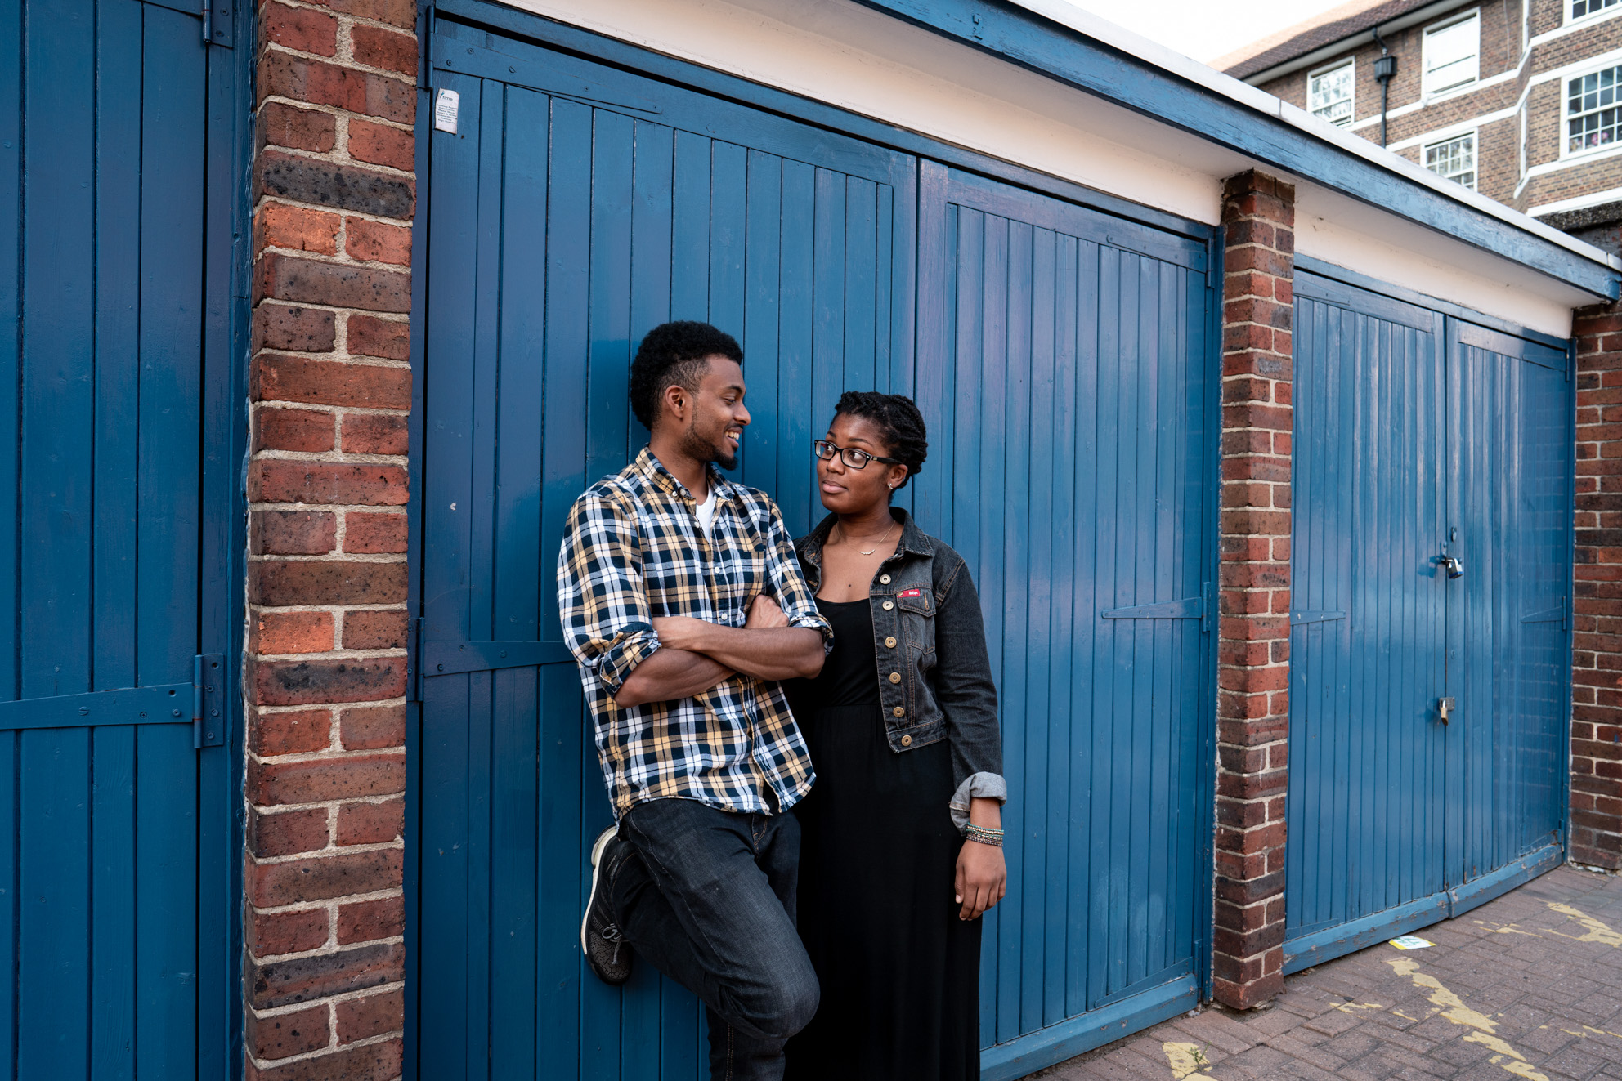
128,032 young people helped through our education & wellbeing work
What is Brook?
Young people rated our clinics 4.88 out of 5 stars
1.4 million young people helped face-to-face and online
Education programmes delivered in 35% of English local authorities
Notes:
Introduce Brook – some suggestions below
“In 1964, Helen Brook created a pioneering health service for young women who couldn’t access contraception anywhere else and desperately needed support. She refused to let stigma stand in the way of what was needed for these young women, despite fierce opposition.
Over 55 years later and Brook is at the forefront of providing sexual health services to young people. We support, educate and empower young people to make their own choices about their sexual health and wellbeing.”
Stats from Brooks Success report 2020 – number for the financial year 2019-2020
This shows we work with thousands of young people every year all over the country, supporting them with issues and questions they might have in around sex, their bodies and relationships
https://www.brook.org.uk/wp-content/uploads/2020/06/BR_SR_FINAL_DIGITAL.pdf
Our values are:
To be collaborative - We value young people’s right to be at the centre of decisions that affect them and work in partnership to provide opportunities to share their views, influence decisions and effect real change.
To be courageous - We relentlessly push the boundaries when fighting for change, supporting young people to build a society where people are free to explore their identities without stigma.
To be Trailblazing - Since 1964 we have championed the pioneering spirit of our founder, leading the way in meeting the ever-changing needs of young people.
To be Trustworthy- Young people rely on Brook’s confidential and non-judgemental approach to speak freely about the issues that affect them.

Slide 3
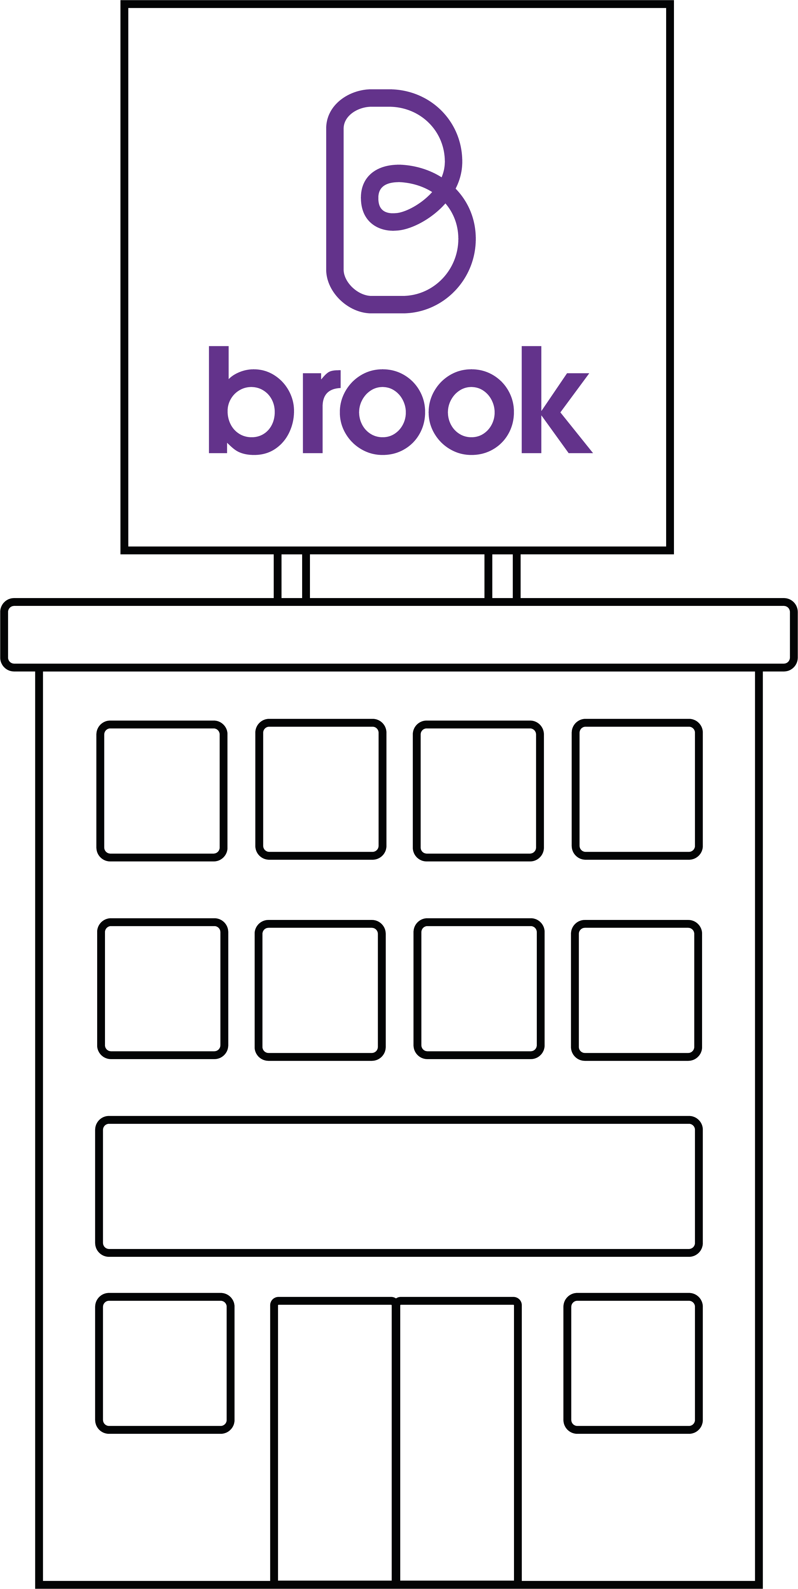
What is Brook?
Relationships & sex education
Advice & information
STI Testing
Contraception methods
FREE condoms
Pregnancy testing & advice
Counselling
brook.org.uk
Notes:
This might not be relevant to you right now, but it might be something for you to think about in the future, or for you to advise a friend or older relative.
Brook has services across the UK providing free and confidential sexual health services to young people under 25. Our Find a Service tool lets you search all services in England - not just Brook. If you haven’t visited Brook before, our visiting Brook page will tell you what to expect and if you need help urgently, we’ve got all the key numbers you need. Introduce local services.
Advice
Free condoms
Free contraception including emergency contraception
Pregnancy and Infection Testing
Someone to talk to
Support around who you fancy whoever that may be

Slide 4
Brook Space
Non- judgemental & Open
Respectful
Safe
Take Part
Ask questions (nothing personal)
Confidential
Fun
Language
Notes:
TASK - Create a Brook Space – Group agreement/ Group Rules
If time allows ask the group for suggestions for a group agreement
Be open but we won’t talk about our own personal lives
Non-judgmental- We will not assume we know what people think and feel or what’s going on in their lives, we accept that everyone is an individual
We will show everyone respect and not embarrass them or make fun of them in class or outside
We will all take part and get involved in the lessons but we have the right to pass on an activity
We will listen to each other
We can ask the teacher any questions (nothing personal though!)
We will try to use the correct language and not slang words, if we don’t know what the right word is we can ask (Mention if relevant)
We can ask for help and support outside class if we need to
Confidential – what we talk about remains in the room, unless we are concerned about you or something/someone you talk about – safeguarding
Make it fun
We will also use gender neutral language in this session, talking about bodies rather than gender to be inclusive or trans/non-binary/ gender fluid people (include if appropriate)

Slide 5
Session outcomes
Define puberty and explore body changes.
Recognise myths and taboos related to puberty
Understand puberty and how it links to wellbeing
Discuss societal ideas about menstruation and assess how these relate to your values
Identify where to go to ask for help and support with questions about our bodies.
Notes:
Facilitator runs through

Slide 6
Notes:
Key messages: Gender & Puberty
For some of us, our bodies and our gender don’t match up. You may feel female and have a penis, you may feel male and have a vulva or may feel like a mix of the two. This is known as being trans, transgender, or genderqueer and can make puberty extra complicated; however puberty can still be positive. It is important for us to think of both gender and sex as a spectrum. This conversation also needs a consideration of the 2010 Equality Act.
Intersex is better known as ‘Difference in Sex Development’ (DSD )– this describes a person whose biology doesn’t easily fit into ‘male’ or ‘female’ sexes and is far more common than we might think. It may mean they experience some aspects of puberty differently.
In this lesson we are going to talk about people’s bodies, not genders
Please speak to someone you trust if anything is worrying you or if you have any questions.

Slide 7
What is puberty?
Notes:
What is puberty?
Method
• Facilitator asks the group what puberty means? Have you learnt about it before? Take some suggestions
• Facilitator defines puberty using key messages and next slide and reinforces that puberty will be different for everyone
Key Questions
• What does puberty mean?
• Is puberty the same for everyone?
• What age does puberty happen?
Key Messages
• Puberty is when people start to change from being a child into an adult. Hormones (chemicals produced by your brain) cause your body to change and grow to become able to biologically conceive a baby. They also affect the way you think and feel.
• This can start any time from 7-16 years old. Not everyone develops at the same age or speed and it can take between 2-4 years to complete. Puberty is different for everyone, try not to compare yourself to other people. Puberty is a big change in adolescence.

Slide 8
Puberty
Puberty is when people start to change from being a child into an adult. Hormones (chemicals produced by your brain) cause your body to change and grow to become able to biologically conceive a baby. They also affect the way you think and feel.
Notes:
In this session, we will be using the terms ‘period’ and ‘menstruation’, because they mean the same thing. Menstruation is the scientific term for a period. They are triggered by hormones released from the brain during puberty.

Slide 9
Puberty myth or fact?
Notes:
Puberty Myths/ Facts
Method
Facilitator explains that we are going to see what you can remember from the lessons and also challenge any myths that might be out there.
Facilitator reads out a statement from the Puberty myths/ facts sheet and asks the group to vote on whether the think it’s a myth or a fact. This can be done either through moving from one side of the room or another, hands up or hands down etc.
Facilitator repeats with all of the statements, answering and then debriefing after each statement
Key Questions
Is masturbating unhealthy?
Is it normal to start having sexual feelings?
How does puberty make someone feel? What can we do to feel more positive?
Key Messages
Please see puberty myths/facts facilitator sheets for specific answers
Developing sexual feelings might happen during puberty; thinking more about sex and potentially who we might fancy. This might mean you start to think about your sexuality (which genders you are attracted to) but don’t worry if you’re not sure yet. In this wild mix of growing, changing and hormones it can take time to work things out.
You may find you want to explore your body and touch areas (penis/ vulva) for sexual pleasure. This is called masturbation and is a normal part of growing up. Make sure to have clean hands and do it in a private place.
Wet dreams are when someone ejaculates whilst asleep. Some people remember having a nice dream but others just wake up to find a wet patch. It’s important to clean up afterwards and change your sheets etc. But remember this is normal and nothing to be worried about, it can just be a part of puberty.
Strategies to manage changes
It’s common to feel embarrassed or overwhelmed about these changes but remember everyone goes through puberty. It’s also an exciting time and part of growing up!
Puberty makes us smellier, try to change your clothes and wash every day using soap or shower gel. Underarm spray such as deodorant (which covers up the smell) or antiperspirants (that stop or dry up sweat) can also help.
You’ll also need to keep your genitals clean. Avoid strong products. Unscented soap and warm water is all you need. If you have foreskin (skin over the head of your penis) wash gently under it to stop it getting smelly, itchy or sore.
Puberty can also affect the way we feel and our emotions can be heightened, especially as we try to cope with the changes to our bodies.
Try to be kind to yourself and people around you, without comparing to others. Do things which may you feel positive and support your mental health. Sleeping enough, doing some exercise (that we enjoy) and eating healthily can also help us feel more positive.
As we grow up we will take more responsibility for our own health. This will involve noticing when our bodies might change, or something feels a bit different to us. But if something does not feel right, we should talk to our parents/carers.
If we have testicles it is important to check them regularly for lumps or swelling in case of cancer, and it is also important that we all check our breasts and learn to recognise if there are any changes. Don’t panic though, these cancers are very rare in young people, but it’s good to get to start knowing your body and asking for help if we are unsure or have any concerns about our health. You’ll learn about this in more detail in later secondary school.
Ask questions if you need help or are confused, make sure you are getting your answers from a reliable source, not just what everyone else is saying.

Slide 10
1. Puberty is the same for everyone
MYTH
Notes:
Myth - Not everyone develops at the same age or speed and it can take between 2-4 years to complete. Puberty is different for everyone, try not to compare yourself to other people.

Slide 11
2. You shouldn’t wash your genitals with perfumed soap
FACT
Notes:
Fact - You’ll need to keep your genitals clean. Avoid strong products. Unscented soap and/or warm water is all you need. Perfumed soaps can disrupt our natural bacterial balance and cause infections such as BV (bacterial Vaginosis). If you have foreskin (skin over the head of your penis) wash gently under it to stop it getting smelly, itchy or sore.

Slide 12
3. We should check our bodies regularly for any changes
FACT
Notes:
Fact - As we grow up we will take more responsibility for our own health. This will involve noticing when our bodies might change, or something feels a bit different to us. But if something does not feel right, we should talk to our parents/carers. If we have testicles it is important to check them regularly for lumps or swelling in case of cancer, and it is also important that we all check our breasts and learn to recognise if there are any changes. Don’t panic though, these cancers are very rare in young people, but it’s good to get to start knowing your body and asking for help if we are unsure or have any concerns about our health. You’ll learn about this in more detail in later secondary school.

Slide 13
4. You have to shave body hair, it’s unhygienic
MYTH
Notes:
Myth – one of the body changes of puberty is growing more hair, on our legs, under arms and genitals particularly. There is a myth that for people with vulvas this hair should be removed because somehow it’s unhygienic or ‘unsightly’. Whether you keep your body hair or remove it, this is personal preference – body hair is not unhygienic, it’s natural. Always remember that your body is your own and it’s up to you what you want to do with it, and that includes how much or how little hair you’d like on it.

Slide 14
5. Puberty can impact on our emotions, as well as bodies
FACT
Notes:
FACT - Puberty can also affect the way we feel and our emotions can be heightened, especially as we try to cope with the changes to our bodies. Try to be kind to yourself and people around you, without comparing to others. Do things which make you feel positive and support your mental health. Sleeping enough, doing some exercise and eating healthily can also help us feel more positive. Part of puberty might involve having sexual feelings, thinking more about sex and potentially who we might fancy. This might mean you start to think about your sexual orientation (which genders you are attracted to) but don’t worry if you’re not sure yet. In this wild mix of growing, changing and hormones it can take time to work things out.

Slide 15
6. Masturbating is bad for you
MYTH
Notes:
Myth - You may find you want to explore your body and touch areas (penis/ vulva) for sexual pleasure. This is called masturbation and is a normal part of growing up. Make sure to have clean hands and do it in a private place. There are myths that masturbating is bad for you, means you can’t have children and even that you will go blind! They aren’t true.

Slide 16
7. Wet dream only happen to boys
MYTH
Notes:
Myth - Wet dreams are when you ejaculate/ orgasm while you’re asleep. Some people remember having a nice dream but others just wake up to find a wet patch. It’s important to clean up afterwards and change your sheets etc. This can happen to everyone regardless of their genders, however, erections and releasing semen only happens if you have a penis. For girls and people with vulvas they may have sexual feelings and orgasm in their sleep. Sometimes (though not always) this can involve release of vaginal fluid as the body is sexually aroused (turned on). They are natural and nothing to be ashamed of. They happen to some people and not others.

Slide 17
8. Period blood is dirty
MYTH
Notes:
Myth – Periods are not ‘dirty’ or ‘smelly’ or any of the other negative stereotypes people have for them. Periods are natural and healthy. .

Slide 18
Menstruation (periods)

Slide 19
What do we think about…?
Notes:
What do we think about? Debate exercise
Method
• Explain that in this activity there are no right or wrong answers. It is about your own views. Everyone may be different and that is okay! No judgements.
• The facilitator may want to explain to the group that we challenge the statement not the person and to ensure the group understand and agree to this; refer back to the group agreement/safe space.
• Facilitator reads out statements and participants go to one end of the room for agree and one end of the room for disagree. The room is a scale, so people may fall somewhere in between.
• Encourage discussion from participants on why they are standing where they are.
Facilitator doesn’t need to use all statements – use ones you think would work best with the group
• Once the facilitator has worked through the statements, ask the group “what affects how you experience and view periods”?
• Ask young people to contribute their ideas about what might impact their experience of their periods. Write answers on the board.
To extent the activity the facilitator could ask the group to write down their thoughts on anonymous post it notes, rather than calling out.
Statements
• When someone is on their period, they can still do everything they usually do in their day-to-day life (swimming/exams/running)
• How we view periods in our society needs to change
• My parents/ carers/ older family members view periods differently to how I do
• Most people are comfortable talking to their dad/ male carer or male members of their family about periods
• Periods should be normal to talk about
• The media has a negative influence on how we view our bodies and periods
• I feel comfortable using the words vagina and vulva
Key Questions
• Do you have to do certain things or not when you’re on your period?
• What should you do if your family has a different view on periods to you?
• Where do you think the ‘taboo’ around periods comes from?
• What are the big influences in young people’s lives?
• Where do we get messages about bodies from?
• What can impact on the way we think about our bodies and puberty?
Key Messages
• We all experience puberty differently
• When speaking about body image and self-esteem, young people may allude to feeling self conscious on their periods because of how their body looks/feels/smells.
• Often menstruators are taught that periods should be hidden, covered up, secret and not talked about. Though there is no ‘wrong’ way to feel, periods are not something to be covered up or ashamed of. They are natural and unique to each person.
• We think we should talk about periods, our bodies and the menstrual cycle openly and make a more period friendly environment.
• “The impact of stigma and shame around menstruation is felt across many areas of young people’s lives, from mental health, body image and self-esteem, to limiting activities and behaviours. It also acts as a barrier to communication and knowledge about bodies, and ways to care for them.” Plan International UK report.
• There are lots of products out there now that mean people who have periods can still enjoy activities without their period interrupting/ or stopping them from taking part
• It is important to respect people’s personal boundaries and beliefs (unless they are harmful)
• It is also important to respect protected characteristics and not discriminate anyone (for example their gender/sexuality)
• There might be ways we can begin to think differently about periods, and ways we can remove the stigma around them.
• Whether we have periods or not, it’s good for us to have an understanding of what they are and to feel comfortable talking about them this can help to break the stigma around periods and to normalise the conversation. So in the future you might want to talk about periods with your partner/someone in your family and feel happy doing so.
• Many messages we receive from society might impact us in different ways. It is important to be critical of what these messages tell us, and to be mindful of how they might impact our well-being.
• See notes on PowerPoint slide for facilitators prompts for “What affects how you experience and view periods” questions if needed.

Slide 20
What affects how you experience and view periods?
Age
Media
Gender Identity
Self-esteem
Education
Living situation
Peer groups
Religion
Family
Financial situation
Disability
Culture
Notes:
Once the facilitator has worked through the statements, ask the group “what affects how you experience and view periods”?
•Ask young people to contribute their ideas about what might impact their experience of their periods. Write answers on the board.
To extent the activity the facilitator could ask the group to write down their thoughts on anonymous post it notes, rather than calling out.
Key Questions
What are the big influences in young people’s lives?
Where do we get messages about bodies from?
What can impact on the way we think about our bodies and puberty?
Key Messages
Many messages we receive from society might impact us in different ways.
It is important to be critical of what these messages tell us, and to be mindful of how they might impact our wellbeing.
Prompts for the facilitator
Living situation; if someone does not have a lot of privacy in their home they might feel awkward when they are on their period (where to put the period products)
Media; are periods spoken about in the media? Is this always positive? What do we think about adverts related to period products?
Education; a lot of our learning about puberty should also come from school, did we learn all about periods at primary school?
Religion and culture; some religions and cultures view periods differently. Some view it as a chance for the person on their period to rest, break from prayer or fasting. Some cultural practices can view periods negatively (i.e. unclean).
Family; how we might have been taught about periods and puberty at home, growing up, our parents/carer, siblings and so on
Financial situation; some people experience period poverty in the UK and across the world. Some people are unable to afford period products; 1/10 in the UK (see Brook website for more information). There are now organisations that provide free products in the UK
Peers; how we might have learnt about periods and puberty from each other, who started their period first
Age; what age we might experience puberty will differ
Self-esteem; during puberty and beyond we will all experience high and low periods of self-esteem. Sometimes puberty can make us feel more self-conscious as our bodies are changing, and it’s important to remember what can increase our self-esteem and resilience during this time; perhaps it’s talking more about how we feel with our friends family, or a teacher, doing this we enjoy, focussing on the things that are going well for us
Disability; for example someone with autism may find that their routine is broken by having a period, routines can be really important for someone with autism. Sometimes young people with a learning disability have not had periods explained to them in a way they can understand. Inclusivity in the conversation about puberty and periods is so important,
Gender identity; language around periods and puberty might not feel inclusive. Some period product brands have become more gender inclusive (taking away the ‘pink’ colour and so on). Gender-neutral language (i.e someone who has a period) in menstruation education is important, otherwise trans-boys/men, non-binary and intersex people who have periods “may exclude themselves” and not receive vital health information. Cis males are sometimes excluded from education about periods, but this can lead to more awkwardness and stigma around the topic, it’s important that all genders learn about body changes to help to normalise these conversations; which will support positive health and wellbeing.

Slide 21
Wellbeing

Slide 22
Advise a Friend
‘I’ve not started puberty yet, all of my friends have, it’s making me worried’ (Sam, 12)
‘I’m finding it really hard to manage my moods, one minute I’m really happy the next minute I feel sad’
(Jack, 14)
‘I just started my period, I don’t have any period products at home, and I don’t think dad can afford them’
(Alex, 13)
Notes:
Method – How could we advise a friend activity
Put the group into pairs, and allocate each pair one of the quotes from the slide, or if time allows ask to consider all 3 scenarios and how they would advise each person
Bring the group together and ask for feedback/discussion, using key questions, messages and prompts to support the discussion.
Key Questions
How can we support our well-being during puberty?
Will we experience puberty differently, and if so how?
Who can we talk to if we are feeling anxious or stressed about these changes?
Key Messages
Different influences can affect our emotional wellbeing, in good ways and bad ways; including body changes.
Puberty may cause us to feel worried, or anxious about the changes that are happening or have not happened. It’s good to talk about how we are feeling.
It is important for us to understand ways to help our emotional wellbeing and resilience. This might be linked to physical activity, time outdoors, hobbies, time spent with friends and family, or helping others.
There are many sources of help and support for our health. Help is something we can always get from an adult we trust like our parent, carer or a teacher. There are also reputable organisations that can offer support digitally, over the phone, by text or face to face.
Prompts for the facilitator
Prompts for the facilitator for Help a friend quotes
Sam is a gender neutral name, consider this scenario from the perspectives of different genders. A reminder that puberty can start between the ages of 7-16 years old. We all grow and change at different rates, and there's nothing you can do to make it happen sooner or later. Your body will change when it's ready. Sam does not need to feel worried but should be supported to talk to someone to help alleviate their concerns
Jack is experiencing changes in their mood and feeling emotional. Jack can be reassured that this is normal and their feelings will settle down eventually. It’s good for Jack to explain how he is feeling to his friends/family and to ensure he does positive activities to support his well-being
Alex might be experiencing period poverty, there are places where Alex can access free period products including at school. Alex might also feel awkward talking to their dad about their periods, perhaps Alex needs support having this conversation. Alex should be reassured about starting their period; this is normal and healthy and advised about the products available.

Slide 23
Summary
Everyone’s bodies are different, which means their experiences of puberty might be different
It’s important that we can challenge myths related to puberty
Puberty might impact how we feel about ourselves so it is important to know where to get support

Slide 24
Where to go for support
An adult you trust at home or school Brook’s website https://www.brook.org.uk/your-life/puberty/ https://www.brook.org.uk/your-life/period-faqs/ Childline – 0800 1111 https://www.childline.org.uk/info-advice/you-your-body/puberty/puberty-facts/ Support for trans and gender-diverse young people https://mermaidsuk.org.uk/
Notes:
Also add local sexual health services for young people, particularly if we are mentioning fertility, sex and conception during this session. Facilitators can be signposted to the Brook – Healthy lives for young people website, and also to Brook Learn.

Slide 25
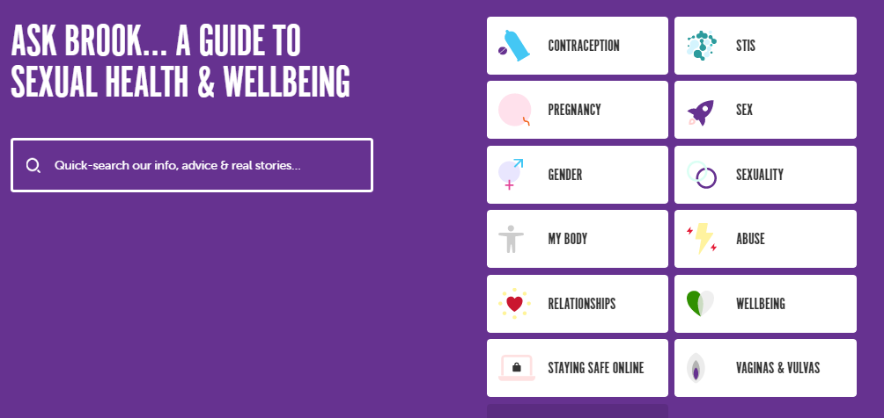
Ask Brook https://www.brook.org.uk/help-advice/

Slide 26
Thank you for listening
We hope you enjoyed it!
Do you have any questions?

