Slide 2
What is Brook?
Brook supports young people to have healthy lives. We provide help for young people with problems and questions about their bodies and relationships.

Slide 3
Safe Space
Feel happy to join in
Kind and respectful to other
Please no personal questions to the teacher or of each other
Confidentiality & keeping you safe
Try to use the correct names for body parts
Fun
Notes:
TASK - Create a Safe Space – Group agreement/ Group Rules – adapt to be appropriate for the age group
If time allows ask the group for suggestions for a group agreement

Slide 4
Session outcomes
Explain what puberty means
Understand that everyone will experience puberty differently
Identify key changes which happen during puberty
Understand key facts about menstruation
Understand where to go for help and support around puberty and their bodies
Notes:
Facilitator runs through
Don’t worry if your not sure what some of these words mean – that’s what we are going to talk about today
Explain that we are going to talk about our bodies

Slide 5
Everyone’s bodies are slightly different
For some people their sex (male/female) does not match their gender
Today we are talking about bodies and not gender
Notes:
Key messages
•Everyone’s bodies, including genitals, are slightly different. We should respect other people not tease or laugh at those who are different to us.
•For some people their biological sex (being male/ female) does not match the gender everyone expected them to be when they were born. This is OK and we should respect how other people feel.
Therefore in this lesson, we are going to talk about people’s bodies, not genders.
In other words, you may feel female and have a penis, you may feel male and have a vulva or may feel like a mix of the two. We’ll learn more about this during PSHE.

Slide 6
Body Parts
Notes:
For some people their biological sex (being male/female) does not match the gender everyone expected them to be when they were born. This is okay and we should respect how other people feel. In this lesson, we are going to talk about people’s bodies, not genders.
Everyone has private parts on their bodies. These are the areas covered by our underwear: bottom, vulva, penis (genitals) and breasts. The genitals are in between someone’s legs and everyone has them. Sometimes these are called private parts or other nick names. It is important to know the correct words for these parts of the body to help us to tell someone if we need help, and to understand body changes experienced during puberty.
Genitals are broadly split into two types – girls, and those with a vulva, and boys, and those who have a penis and testicles
Sometimes it can feel a bit awkward to talk about genitals because we are not used to talking about bodies and they are our private parts. However, it is not rude or wrong to understand how our bodies work and know the correct words.
Everyone’s bodies, including genitals, are slightly different. We should respect other people – not tease or laugh at those who are different to us.

Slide 7
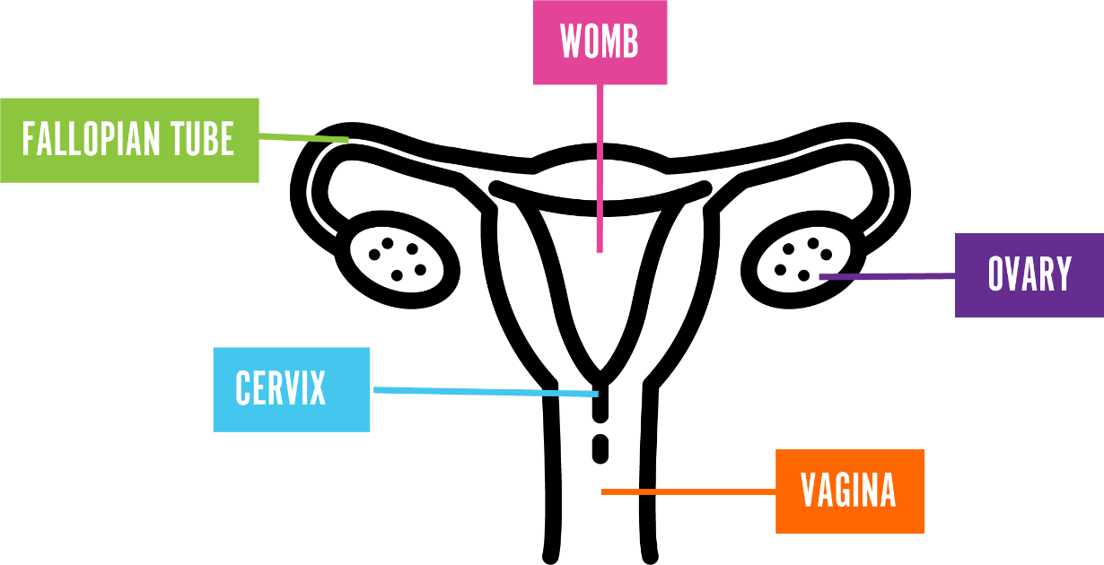
Internal reproductive organs
Womb
Fallopian Tubes
Ovary
Cervix
Vagina
Notes:
Explain that this is what is inside someone’s body who has a vulvas and vagina and is part of the internal reproductive system/ organs, they will learn more about this in year 6 too.
• Ovary – people have two of these and this is where the eggs are stored inside someone’s body. The eggs are needed to help grow a baby and are so tiny you can’t see them with the naked eye
• The fallopian tube- people have two of these. They connect the ovary to the womb.
• Womb – sometime this is also called the uterus. This is where a baby might grow if someone was pregnant
• Cervix – this acts as a barrier to stop anything getting into the body through the vagina. It has a very small hole in it to allow sperm in or period blood out
• Vagina – this is a tube which connects the womb and cervix to the outside of the body.

Slide 8
Internal reproductive organs
Sperm Ducts
Penis
Glands
Testicles
Urethra
Notes:
This is what it looks like inside someone with a penis, this is their internal reproductive organs/ system
Penis – is made up of spongy tissue which hangs outside the body between someone’s legs. Some penises have a foreskin over the end of the penis to protect this sensitive area. It is important to gently pull the foreskin back to clean under it when you are having a wash. Some people might have had their foreskin removed during an operation by a doctor.
Urethra – this is a tube running inside a penis, connecting to the bladder and sperm ducts. It carries urine (wee/ pee) out of the body. It can also carry sperm out of the body through the penis.
Testicles – people have two of these and they hang outside of the body beside the penis. This is where sperm is made and stored. Sperm is something which is needed to grow a baby. Like the penis they are very sensitive to being touched.
Sperm Ducts- these help with the transfer of sperm from the testicles out to the penis
Glands –(prostate gland) this makes the fluid which helps the sperm travel to the penis. The fluid is called semen.

Slide 9
Puberty
Puberty is when people start to change from being a child into a young adult.
People will start puberty at a slightly different time and will develop differently – it’s important to respect that we are all different.
Notes:
•Facilitator asks the group what puberty is and gives some key facts (if not covered in the introduction).
Key Messages
Puberty is when people start to change from being a child into a young adult.
Puberty starts sometime between the ages of 7 and 16 and the process takes several years to complete. The speed in which these changes happen are different for everyone.
Hormones become very active and are responsible for growth and development during puberty. Hormones are chemicals that tell cells and body parts to do certain things.
Puberty changes are a normal part of growing up.
People will start puberty at a slightly different time and will develop differently – it’s important to respect that we are all different.
Puberty is a time for new opportunities and feelings. You will have new responsibilities to take care of yourself and you may want more independence.
Some changes happen only to people with a penis, some only to people with a vulva; some happen to both.

Slide 10
What changes might we experience when we go through puberty?

Slide 11
Changes we might experience
Notes:
Method
Keep the definition of the word puberty at the front of the room (where the children can see it)
Children can either use the body changes worksheet (body outline) or draw their own person – encourage group to keep this gender non-specific
Children can work in pairs to come up with all of the changes that might happen to someone as they experience puberty for any gender
Offer children prompts if they are struggling with ideas and encourage children to think about changes that also might happen to emotions
Use the slides to discuss the different changes people might experience during puberty
Key Questions
Can it feel awkward to talk about these things? Why?
What does puberty mean?
Is puberty the same for everyone?
What age does puberty happen?
What are some changes which happen during puberty?
Are all the changes physical?
Do you need to wash more when puberty starts? Why?
How does puberty make someone feel? What can we do to feel positive?
What is a wet dream?
Why do you think it is important to talk about these changes before they happen?
Key Messages
Everyone’s bodies, including genitals, are slightly different. We should respect other people – not tease or laugh at those who are different to us.
Genitals are broadly split into two types – girls, and those with a vulva, and boys, and those who have a penis and testicles.
As you get older your body goes through a number of changes, called puberty.
Remember puberty is when people start to change from being a child into a young adult.
The speed of these changes will be different for everyone.
Puberty starts sometime between the ages of 7 and 16 and the process takes several years to complete.
Hormones become very active and are responsible for growth and development during puberty. Hormones are chemicals that tell cells and body parts to do certain things.
Puberty changes are a normal part of growing up.
People will start puberty at a slightly different time and will develop differently – it’s important to respect that we are all different.
Puberty is a time for new opportunities and feelings. You will have new responsibilities to take care of yourself and you may want more independence.
Some changes happen only to people with a penis, some only to people with a vulva; some happen to both.
During puberty you might start thinking about who you fancy and start thinking about sexual things. But not everyone does.
Wet dreams are when you ejaculate (release fluid containing sperm out of the penis) when you’re asleep. This happens to some people and not to others. It is normal. It’s important to clean up afterwards and change your sheets and pyjamas.
The hormones released in puberty can impact our emotions and feelings. Make sure you are kind to yourself and others.
Do things which help you feel positive. Getting enough sleep, doing some exercise and eating healthily can also help.

Slide 12
For everyone
Grow Taller
You may get spots.
Get more hair – under your arms, on your legs and genitals, sometimes face and chest too
Get sweatier, smellier and greasier hair
The hormones released in puberty can impact our emotions and feelings
You might start thinking about who you fancy
You may want more independence and to take some more responsibility for yourself.
Notes:
•Grow Taller (you might feel more achy or tired as a result).
•You may get spots.
Get more hair – under your arms, on your legs and genitals, sometimes face and chest too
during puberty we get sweatier, especially under our arms and in between our legs. People may choose to use deodorant or antiperspirant under their arms to help reduce their body odour.
during puberty people’s hair gets greasier so it’s important to wash your hair more often. We also get sweatier and smellier, so it’s important to have a wash every day. However, we should not wash our genitals with strong perfumed soap as this can cause them to become itchy or sore. Just warm water and/ or unperfumed soap is fine. If you have a foreskin (skin over the end of the penis), gently pull this back to clean underneath when you wash.
•The hormones released in puberty can impact our emotions and feelings. Make sure you are kind to yourself and others. Do things which help you feel positive. Getting enough sleep, doing some exercise and eating healthily can also help.
•During puberty you might start thinking about who you fancy and start thinking about sexual things.
•You may want more independence and to take some more responsibility for yourself.

Slide 13
Changes if you are a girl, have a vulva
Your nipples and breasts will get bigger (you might wear a bra).
Your body shape may grow more curvy and your hips may get wider.
You might start to get vaginal discharge - clear/milky liquid in your underwear which keeps the vagina healthy.
Your periods might start.
Notes:
Your nipples and breasts will get bigger (you might wear a bra).
Your body shape may grow more curvy and your hips may get wider.
You might start to get vaginal discharge - clear/milky liquid in your underwear which keeps the vagina healthy.
Your periods will start.

Slide 14
Changes if you are a boy, have a penis
Your voice deepens (voice changes).
Your muscles develop and your chest gets broader.
Your genitals (penis and testicles) grow larger.
Your nipples can become sensitive for a short time and may swell.
You may get erections & wet dreams
Notes:
Your voice deepens (voice changes).
Your muscles develop and your chest gets broader.
Your genitals (penis and testicles) grow larger.
Your nipples can become sensitive for a short time and may swell.
You will begin to get erections (when the penis grows stiff and sticks out from your body), when you least expect them!!
Wet dreams are when you ejaculate (release fluid containing sperm out of the penis) when you’re asleep. This happens to some people and not to others. It is normal. It’s important to clean up afterwards and change your sheets and pyjamas.
**Note to explain if appropriate for the group** girls and people with vulvas can have ‘wet dreams’ in that they can orgasm (pleasurable sexual feeling) when they are asleep but this doesn’t involve an erection or ejaculation of sperm.

Slide 15
What is menstruation or a period?
Notes:
What is menstruation or a period?
Method
Facilitator explains we are going to think a bit more about menstruation or periods.
Facilitator then shows the group an image of a menstrual cycle wheel and reinforces key messages.
Facilitator then asks the group how someone might feel just before and during their period. Use key messages to debrief.
Facilitator can then show period product options - these might have been covered in the puberty changes bag activity.
Key Questions
What is menstruation or a period?
Who has a period and why?
What can someone use to catch the period blood?
Are periods dirty?
Should we tease people who experience puberty differently to us?
Key Messages
Periods start at some point during puberty (girls, and those with a vulva), although some people’s periods don’t start until they are 16 or 17. There’s no right or wrong age to start having periods. If they don’t start by the age of about 16 then it’s good to talk with a doctor.
Periods are just one part of the menstrual cycle. A menstrual cycle starts on the day that you get your period and lasts until the day before your next one.
On average people have a period every month (but it can be longer or shorter than this)
The ovaries release an egg and the womb lining becomes spongy and thick. If the egg isn’t fertilised by sperm, the egg and womb lining is not needed and comes out through the vagina as blood.
This bleeding is known as a period and lasts 3-8 days. Period blood can be pink, brown or red and have clots in it.
Sometimes people have some signs their period is on the way, you might feel more tired, have more spots, headaches, sore breasts, upset stomach or feel a bit more emotional than usual. Everyone is different so may have some signs or none.
During your period some people get cramps which feel like a sore stomach or lower back. Painkillers, a hot water bottle or gentle exercise can help.
There are different options for catching the period blood, pick what works for you. There are pads, tampons, menstrual cups and period pants.
Periods are natural and normal. They are not dirty.

Slide 16
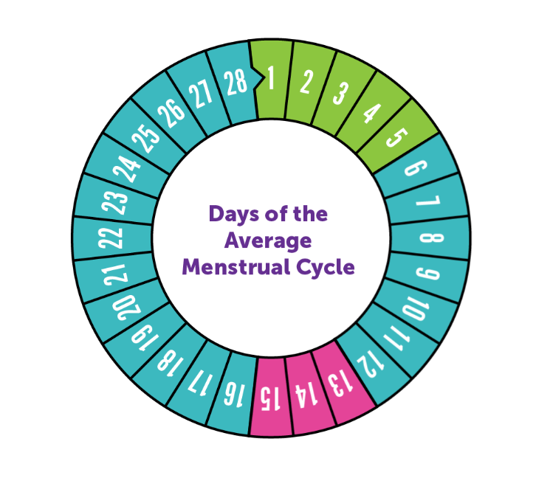
Menstrual Cycle
Period
Post Ovulation
New Egg
Matures
Ovulation
Notes:
Facilitator then shows the group an image of a menstrual cycle and reinforces key messages.
Facilitator then asks the group how someone might feel just before and during their period. Use key messages to debrief.
Facilitator can then show period product options - these might have been covered in the puberty changes bag activity.
Key Questions
What is menstruation or a period?
Who has a period and why?
What can someone use to catch the period blood?
Are periods dirty?
Should we tease people who experience puberty differently to us?
Key Messages
Periods are just one part of the menstrual cycle. Day 1 of the menstrual cycle is the day that you get your period, and the menstrual cycle lasts until the day before your next one.
On average people have a period every month (but it can be longer or shorter than this)
A new egg grows and matures between days 6 and 12 of the menstrual cycle
Around day 13 or 14 of the menstrual cycle the ovaries release an egg and the womb lining becomes spongy and thick. This is called ovulation.
Post ovulation is the time after the egg is released
If the egg isn’t fertilised by sperm, the egg disperses in the uterus and comes out through the vagina as blood.
This bleeding is known as a period and lasts 2-10 days. Period blood can be pink, brown or red and have clots in it.
Sometimes people have some signs their period is on the way, you might feel more tired, have more spots, headaches, sore breasts, upset stomach or feel a bit more emotional than usual. Everyone is different so may have some signs or none.
During your period some people get cramps which feel like a sore stomach or lower back. During your period some people get cramps which feel like a sore stomach or lower back. A warm bath, hot water bottle and keeping active can help. Any pain relief medication should only be given under adult supervision.
There are different options for catching the period blood, pick what works for you. There are pads, tampons, menstrual cups, liners and period pants.
Periods are natural and normal. They are not dirty.

Slide 17
Puberty Quiz
Notes:
Puberty quiz.
Method
Facilitator asks the group to stand up and explains that they are going to read out a statement. If you think it is true go to one side of the room and if you think it is false go to the other side of the room.
Facilitator then reads out statements and debriefs each one.
If movement is not possible thumbs up and down can be used with the group instead
Key Messages
Reinforce key messages already discussed in the lesson.
Please use facilitator debrief sheet for specific points.

Slide 18
1. Puberty is the same for everyone
FALSE
Notes:
False - people will start puberty at a slightly different time and will develop differently, it’s important to respect that we are all different.
The biggest difference is whether someone has a penis or a vulva, as this will effect which changes might happen to them during puberty.

Slide 19
2. Puberty starts for everyone when they are 21 years old
FALSE
Notes:
False - puberty starts sometime between the ages of 7 and 16 and the process takes several years to complete. Remember is starts at different times, it’s important we try not to compare ourselves to our friends.

Slide 20
3. It’s important to learn about these changes, even though it can feel awkward
TRUE
Notes:
True – though it can feel awkward to talk about our bodies it’s very important. It helps us feel more prepared for what might happen during puberty, so it’s less confusing and scary. We can also understand that puberty happens to everyone and where to go if we have questions. Talking about puberty also helps us to learn how to take care of ourselves to keep us healthy, both in our bodies but also with our feelings.

Slide 21
4. It’s important to wash more often once we reach puberty
TRUE
Notes:
True – during puberty our bodies get sweatier and smellier. Our hair also gets greasier. It’s important to wash every day and change our clothes regularly. We may choose to use deodorant or antiperspirant to prevent body odour.

Slide 22
5. Everyone will get lots of spots during puberty
FALSE
Notes:
False – getting spots is a common change during puberty (this can be on your face, back or anywhere on your body) but not everyone will get them and you might not have lots. It’s very normal and you can still get spots as an adult. Sometimes the doctor can help too.

Slide 23
6. The hormones which cause changes during puberty, can also affect how we feel
TRUE
Notes:
True - the hormones released in puberty can impact our emotions and feelings. Make sure you are kind to yourself and others. Do things which help you feel positive. Getting enough sleep, doing some exercise and eating healthily can also help.
During puberty you might also start thinking about who you fancy, but not everyone does.

Slide 24
7. Everyone will get their period during puberty
FALSE
Notes:
False – only people with vulvas and wombs can get periods. They start during puberty and happen on average about once a month.

Slide 25
8. More hair grows on our bodies during puberty
TRUE
Notes:
True – one of the changes of puberty is getting hairier. People may get more hair on their legs, under their arms and on their genitals. People with penises tend to be more hairy, but not always – hair might grow on their chins and upper lip, chest and backs too.

Slide 26
9. Period pads and tampons are used to manage period blood
TRUE
Notes:
True - there are different options for catching the period blood, pick what works for you. There are pads, tampons, menstrual cups and period pants. Periods are natural and normal. They are not dirty and it’s fine to talk about them.

Slide 27
10. If you have a question about puberty, just keep it to yourself
FALSE
Notes:
False – If you have questions or problems relating to your body or what we’ve discussed in this lesson please speak to an adult you trust. This is all apart of growing and changing, and it’s great to talk about.

Slide 28
Summary
Puberty is when people start to change from being a child into a young adult.
People will start puberty at a slightly different time and will develop differently – it’s important to respect that we are all different.
If you have questions about puberty or your body please speak to an adult you trust

Slide 29
Where to go for help and questions
An adult you trust at home or school Come and speak to the facilitator after a lesson Brook’s website https://www.brook.org.uk/your-life/puberty/ ChildLine – 0800 1111 https://www.childline.org.uk/

Slide 30
Thank you for listening
We hope you enjoyed it!
Do you have any questions?

