Slide 2
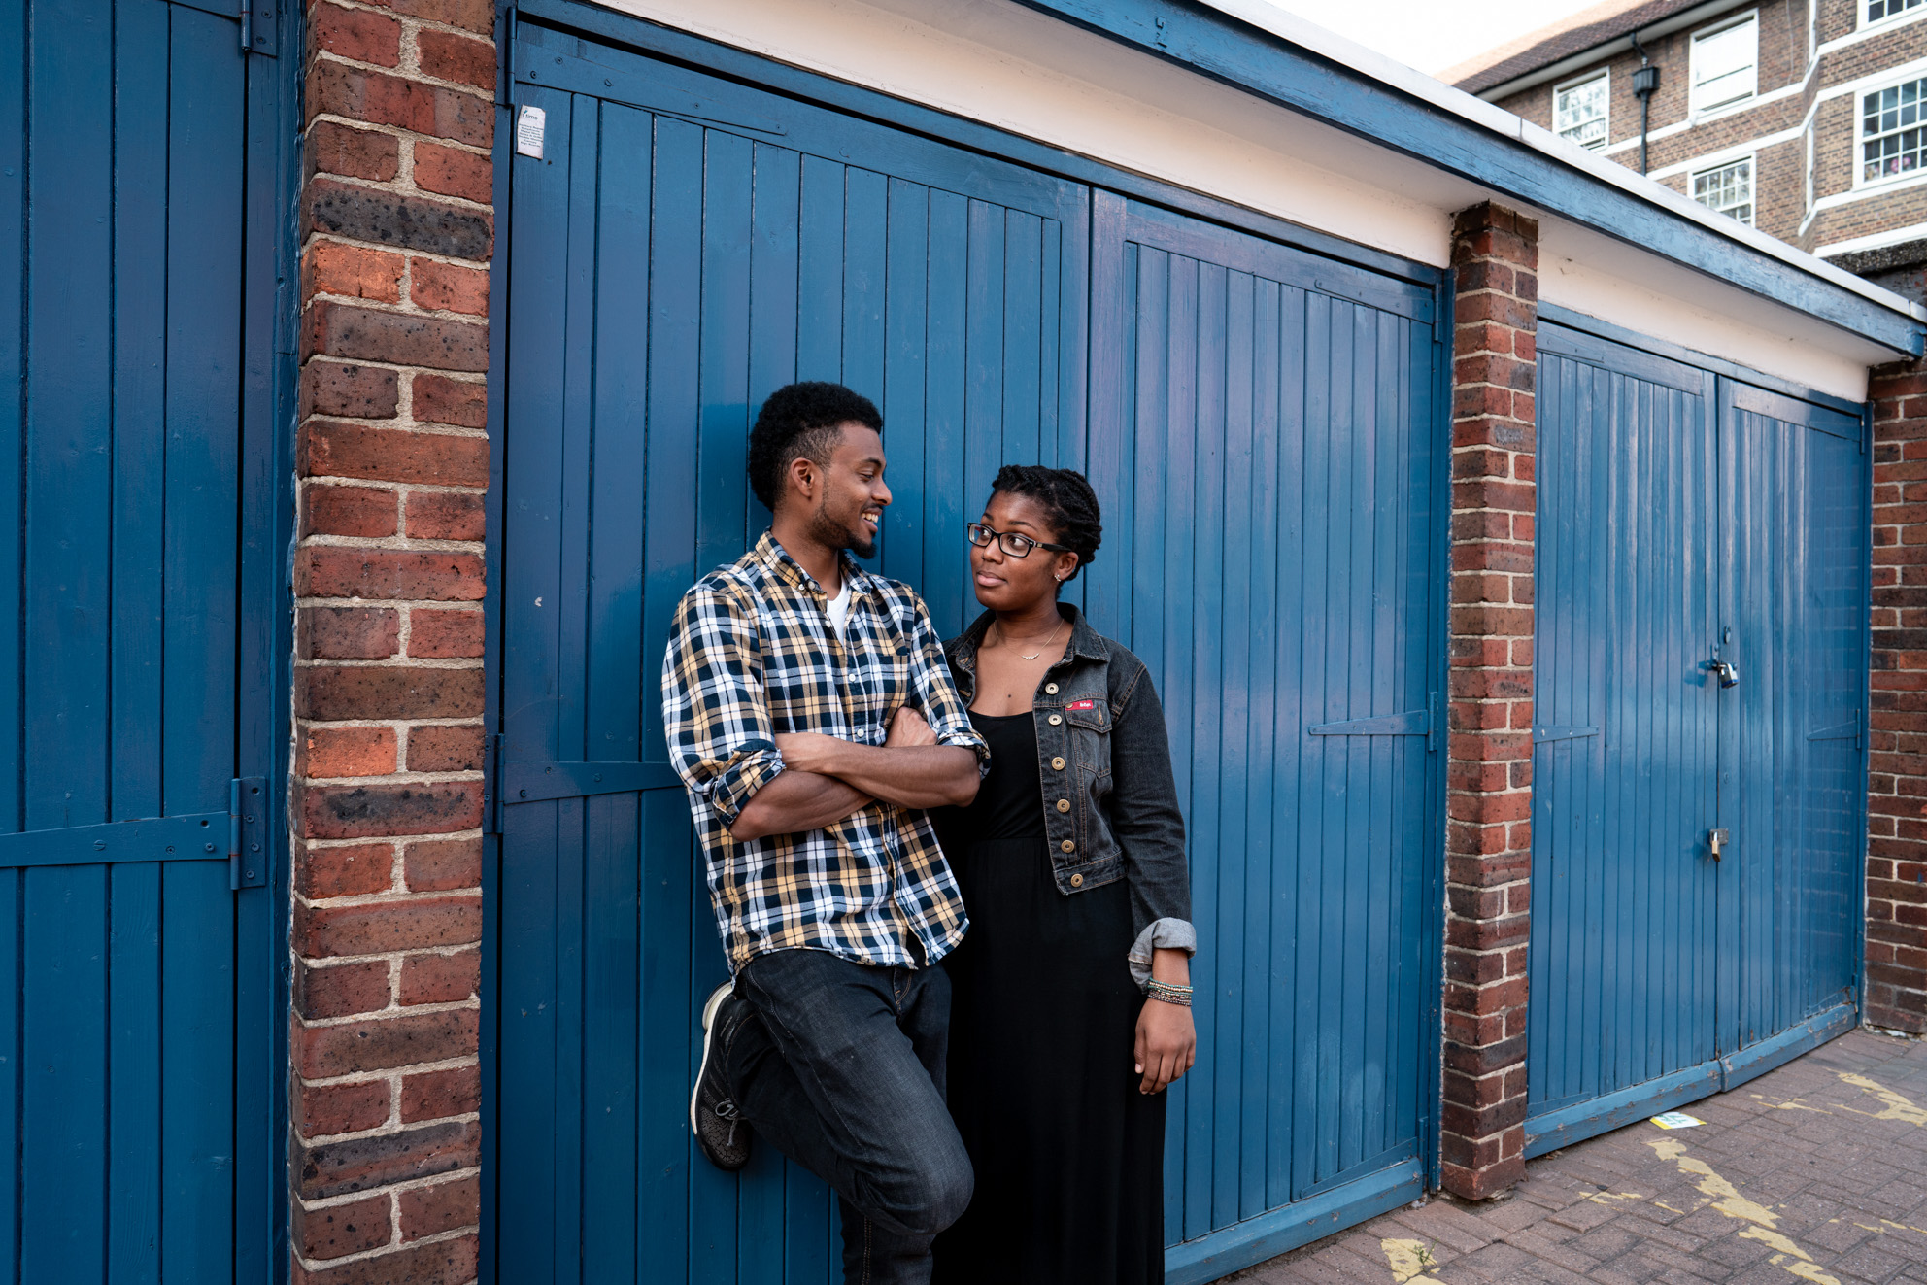
128,032 young people helped through our education & wellbeing work
What is Brook?
Young people rated our clinics 4.88 out of 5 stars
1.4 million young people helped face-to-face and online
Education programmes delivered in 35% of English local authorities
Notes:
Introduce Brook – some suggestions below
“In 1964, Helen Brook created a pioneering health service for young women who couldn’t access contraception anywhere else and desperately needed support. She refused to let stigma stand in the way of what was needed for these young women, despite fierce opposition.
Over 55 years later and Brook is at the forefront of providing sexual health services to young people. We support, educate and empower young people to make their own choices about their sexual health and wellbeing.”
Stats from Brooks Success report 2020 – number for the financial year 2019-2020
This shows we work with thousands of young people every year all over the country, supporting them with issues and questions they might have in around sex, their bodies and relationships
https://www.brook.org.uk/wp-content/uploads/2020/06/BR_SR_FINAL_DIGITAL.pdf
Our values are:
To be collaborative - We value young people’s right to be at the centre of decisions that affect them and work in partnership to provide opportunities to share their views, influence decisions and effect real change.
To be courageous - We relentlessly push the boundaries when fighting for change, supporting young people to build a society where people are free to explore their identities without stigma.
To be Trailblazing - Since 1964 we have championed the pioneering spirit of our founder, leading the way in meeting the ever-changing needs of young people.
To be Trustworthy- Young people rely on Brook’s confidential and non-judgemental approach to speak freely about the issues that affect them.

Slide 3
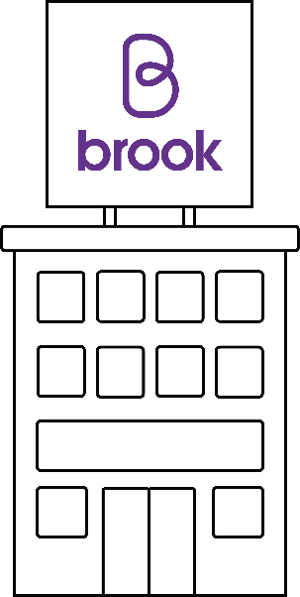
What is Brook?
Relationships & sex education
Advice & information
STI Testing
Contraception methods
FREE condoms
Pregnancy testing & advice
Counselling
brook.org.uk
Notes:
This might not be relevant to you right now, but it might be something for you to think about in the future, or for you to advise a friend or older relative.
Brook has services across the UK providing free and confidential sexual health services to young people under 25. Our Find a Service tool lets you search all services in England - not just Brook. If you haven’t visited Brook before, our visiting Brook page will tell you what to expect and if you need help urgently, we’ve got all the key numbers you need. Introduce local services.
Advice
Free condoms
Free contraception including emergency contraception
Pregnancy and Infection Testing
Someone to talk to
Support around who you fancy whoever that may be

Slide 4
Brook Space
Non- judgemental & Open
Respectful
Safe
Take Part
Ask questions (nothing personal)
Confidential
Fun
Language
Notes:
TASK - Create a Brook Space – Group agreement/ Group Rules
If time allows ask the group for suggestions for a group agreement
Be open but we won’t talk about our own personal lives
Non-judgmental- We will not assume we know what people think and feel or what’s going on in their lives, we accept that everyone is an individual
We will show everyone respect and not embarrass them or make fun of them in class or outside
We will all take part and get involved in the lessons but we have the right to pass on an activity
We will listen to each other
We can ask the teacher any questions (nothing personal though!)
We will try to use the correct language and not slang words, if we don’t know what the right word is we can ask (Mention if relevant)
We can ask for help and support outside class if we need to
Confidential – what we talk about remains in the room, unless we are concerned about you or something/someone you talk about – safeguarding
Make it fun
We will also use gender neutral language in this session, talking about bodies rather than gender to be inclusive or trans/non-binary/ gender fluid people (include if appropriate)

Slide 5
Session outcomes
Define what puberty means and consolidate previous knowledge, awareness of bodies
Examine our own values towards periods
Think critically about how puberty and menstruation is portrayed in society
Understand where to go to ask for help and support with questions about our bodies.
Notes:
Facilitator runs through

Slide 6
Notes:
Key messages
1.For some of us, our bodies and our gender don’t match up. You may feel female and have a penis, you may feel male and have a vulva or may feel like a mix of the two. This is known as being trans, transgender, or genderqueer and can make puberty extra complicated; however puberty can still be positive. Please speak to someone you trust if anything is worrying you or if you have any questions.
2.Intersex – this describes a person whose biology doesn’t easily fit into ‘male’ or ‘female’ sexes and is far more common than we might think. It may mean they experience some aspects of puberty differently.
Therefore in this lesson, we are going to talk about people’s bodies, not genders

Slide 7
What is puberty?
Notes:
• Facilitator asks the group what puberty is and gives some key facts, using key messages below.
• Facilitator then asks the group to define a period or menstruation, before running through the definition using the key messages below.
Puberty and periods
Method
Facilitator explains that during this session we are going to be talking about people’s bodies rather than referring to puberty changes based on gender. This is because we want to be inclusive of people who identify as trans, non-binary or inter-sex.
For some of us, our gender identity if not the one everyone expected when we were born based on our genitals. You may feel female and have a penis, you may feel male and have a vulva or may feel like a mix of the two. This is known as being trans, transgender, or genderqueer and can make puberty extra complicated; however puberty can still be positive. Please speak to someone you trust if anything is worrying you or if you have any questions.
Intersex – this describes a person whose biology doesn’t easily fit into ‘male’ or ‘female’ sexes and is far more common than we might think. It may mean they experience some aspects of puberty differently. (For more information please visit Brook’s website)
Facilitator asks the group what puberty is and gives some key facts, using key messages below.
Facilitator then asks the group to define a period or menstruation, before running through the definition using the key messages below.
Key Questions
Can it feel awkward to talk about these things? Why?
Is puberty the same for everyone?
What are some changes which happen during puberty?
Why do you think it is important to talk about these changes before they happen?
How do we speak about periods in society?
How might people feel on their period (symptoms)?
Key Messages
Puberty is when people start to change from being a child into a young adult. Hormones (chemicals produced by your brain) cause your body to change and grow to become able to biologically conceive a baby. They also affect the way you think and feel.
This can start any time from 7-16 years old. Not everyone develops at the same age or speed and it can take between 2-4 years to complete.
Puberty changes are a normal part of growing up.
People will start puberty at a slightly different time and will develop differently – it’s important to respect that we are all different.
Puberty is a time for new opportunities and feelings. You will have new responsibilities to take care of yourself and you may want more independence.
Some changes happen only to people with a penis, some only to people with a vulva; some happen to both.
The hormones released in puberty can impact our emotions and feelings. Make sure you are kind to yourself and others.
In this session, we will be using the terms ‘period’ and ‘menstruation’, because they mean the same thing. Menstruation is the scientific term for a period. They are triggered by hormones released from the brain during puberty.
Every month (ish), the ovaries release an egg – this is called ovulation. If this egg is not fertilised by a sperm, it is shed through the vagina along with the lining of the womb, and this is what period blood is. Some people’s menstrual cycle may last away between 21 and 40 days
The average age to start is 12 but most people’s periods start between 8 and 17. If you have not started your period by the time you are 17 it is a good idea to speak to a doctor.
There’s no ‘normal’ period or cycle, everyone is different! But usually they last a few days (commonly 3-8 days) passing between 5-12 teaspoons of pink, red or brown blood – this can be thick or watery. Periods can be irregular, heavy or light and can change throughout your life.
Menstrual wellbeing is an important part of self-care, and wider education around bodies. Part of this is preparing yourself for the practicalities of having a period, seeing what works best for you and your cycle.
“See a GP if your periods haven't started by age 16 (or 14 if there are no other signs of puberty either)” NHS website
“Signs that your period is on its way are if you've grown underarm and pubic hair. Typically, you'll start your periods about 2 years after your breasts start growing and about a year after getting a white vaginal discharge. The average girl will get her first period around 12 years old, but it varies from person to person.” NHS website
Some common signs that you may have before or during your period are feeling cramps in your lower stomach or back, feeling tense, emotional or irritable before a period (known as PMS), breast tenderness, spots, upset stomach, tiredness, bloating, headaches. You won’t necessarily get all or any of these signs – everyone is different.
Cramps can be eased by taking Paracetamol or ibuprofen(always follow instructions carefully), using a hot water bottle, having a hot bath or doing some gentle exercise. Period cramps can be uncomfortable, but should not stop you doing normal things like going to school or work. If they are very painful please go to see your doctor for advice.
These symptoms looks like periods are awful but they’re not all bad! Use your period as an opportunity to look after yourself, do what you enjoy! Light exercise, getting enough sleep, eating a balanced diet, doing your favourite hobby/distracting yourself, painkillers, hot water bottles and warm baths can all help.
Everyone experiences their period symptoms differently, but society is not always ready to speak about them. Let’s think about how we can change this!

Slide 8
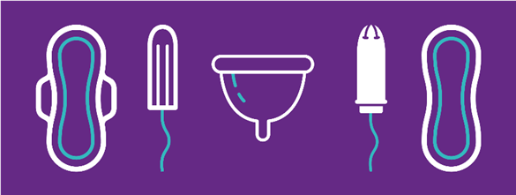
What is a period?
Every month (ish), the ovaries release an egg – this is called ovulation. If the egg isn’t fertilised by sperm, the egg disperses in the uterus and comes out through the vagina as blood, and this is what period blood is. Some people’s menstrual cycle may last away between 21 and 40 days
Notes:
In this session, we will be using the terms ‘period’ and ‘menstruation’, because they mean the same thing. Menstruation is the scientific term for a period. They are triggered by hormones released from the brain during puberty.
• Every month (ish), the ovaries release an egg – this is called ovulation. If the egg isn’t fertilised by sperm, the egg disperses in the uterus and comes out through the vagina as blood, and this is what period blood is. Some people’s menstrual cycle may last away between 21 and 40 days
• The average age to start is 12 but most people’s periods start between 8 and 14. If you have not started your period by the time you are 18 it is a good idea to speak to a doctor.
• There’s no ‘normal’ period or cycle, everyone is different! But usually they last a few days (commonly 2-10 days) passing between 5-12 teaspoons of pink, red or brown blood – this can be thick or watery. Periods can be irregular, heavy or light and can change throughout your life.
“See a GP if your periods haven't started by age 18 (or 14 if there are no other signs of puberty either)” NHS website
“Signs that your period is on its way are if you've grown underarm and pubic hair. Typically, you'll start your periods about 2 years after your breasts start growing and about a year after getting a white vaginal discharge. The average girl will get her first period around 12 years old, but it varies from person to person.” NHS website

Slide 9
Period symptoms
Cramps
Spots
Breast tenderness
Feeling bloated
Feeling tired and/or more emotional
Larger appetite
We are all different.
Some people have many symptoms, some don’t have any.
If you feel your period is negatively impacting your life, there’s things you can do to help.
All of these are caused by hormone changes
Notes:
• Some common signs that you may have before or during your period are feeling cramps in your lower stomach or back, feeling tense, emotional or irritable before a period (known as PMS), breast tenderness, spots, upset stomach, tiredness, bloating, headaches. You won’t necessarily get all or any of these signs – everyone is different.
• During your period some people get cramps which feel like a sore stomach or lower back. A warm bath, hot water bottle and keeping active can help. Any pain relief medication should only be given under adult supervision. Period cramps can be uncomfortable, but should not stop you doing normal things like going to school or work. If they are very painful please go to see your doctor for advice.
• These symptoms make it seem like periods are awful but they’re not all bad! Use your period as an opportunity to look after yourself, do what you enjoy! Light exercise, getting enough sleep, eating a balanced diet, doing your favourite hobby/distracting yourself, painkillers, hot water bottles and warm baths can all help.
• Everyone experiences their period symptoms differently, but society is not always ready to speak about them. Let’s think about how we can change this!

Slide 10
Period Pitch activity
Notes:
Period Pitch Activity
Method
• Facilitator hands out cards with images of different period products on them. Divide young people into groups of 3-5.
• After a few minutes of preparation time, each group go to the front of the class and give an ‘elevator pitch’ about said product, although they can’t mention the actual name of the product. They can also draw on the whiteboard, and using words or gestures – like in charades. The aim is to ‘sell’ their product to the rest of the class!
• Facilitator debriefs using key messages
Key Questions
• Why might people use different period products?
• Is there a taboo about speaking about periods? Why is there a taboo about speaking about period products in society (encourage home vs. school debate)
• Do we need to think about sustainability when selecting products?
Key Messages
• Please see product pitch cards for more information
• People generally use a combination of products. Most come in different sizes and to suit different flows (heavy or light). Experiment to find what works best for you. No one type of product is better, it’s just the best option for that person.
• The cost of period products might be a factor in which ones you choose. Some of the multi-use, sustainable period products are available but require more money to buy them, though you may save money over time.
• Having an emergency period product with you when you are out and about can be a good idea. But remember you can always ask friends or an adult you trust too. This is also true if you haven’t started yet.

Slide 11
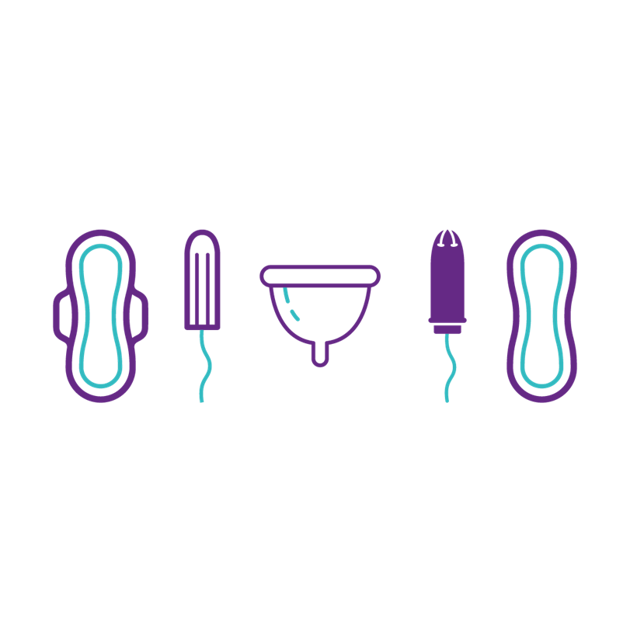
Experiment to find what works best for you. No one type of product is better, it’s just the best option for that person.

Slide 12
Name the “bits”
Notes:
Label the body
Method
• Facilitator explains that we are going to think about genitals in more detail and understand the correct words for different parts and what they are for.
• Facilitator shows images of the internal reproductive system, first one then the other on a presentation. Facilitator may choose to have the areas unnamed to see if anyone in the group knows the names, before revealing the answers.
• Using the facilitator debrief sheet, questions and keys messages, facilitator explains the names and functions of each element of the internal reproductive system.
Questions
• Is everyone’s body the same?
• What is the name for the area between a person’s legs?
• How can we keep our genitals clean?

Slide 13
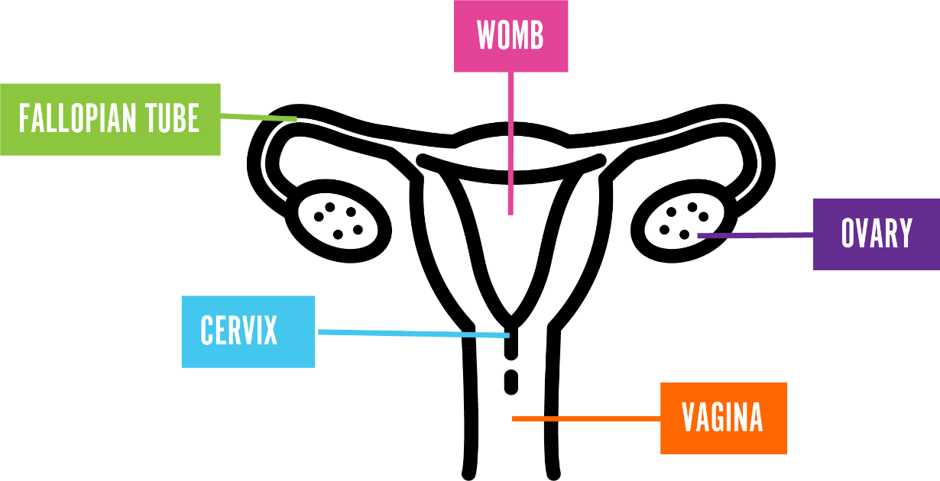
Internal reproductive organs
Womb
Fallopian Tubes
Ovary
Cervix
Vagina
Notes:
Explain that this is what is inside someone’s body who has a vulvas and vagina and is part of the internal reproductive system/ organs
• Ovary – people have two of these and this is where the eggs are stored inside someone’s body. The eggs are needed to help make a baby and are so tiny you can’t see them with the naked eye
• The fallopian tube- people have two of these. They connect the ovary to the womb.
• Womb – sometime this is also called the uterus. This is where a baby might grow if someone was pregnant
• Cervix – this acts as a barrier to stop anything getting into the body through the vagina. It has a very small hole in it to allow sperm in or period blood out
• Vagina – this is a tube which connects the womb and cervix to the outside of the body.

Slide 14
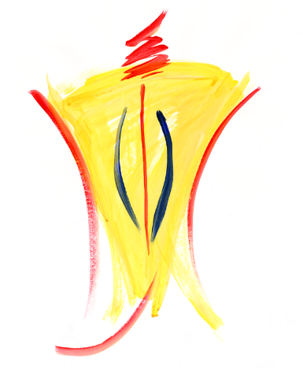
All vulvas are different
Just like other parts of the body, all vulvas are different and unique.
Notes:
•Use plain, unperfumed soap every day to gently wash your vulva. Never clean inside the vagina (douche) as it washes out the good bacteria. Always wipe front to back, to avoid transferring bacteria from the anus.
We often refer to the external genital organs (the bits you can see) as the vagina, but this is actually called the vulva.
• We often refer to the external genital organs (the bits you can see) as the vagina, but this is actually called the vulva..

Slide 15
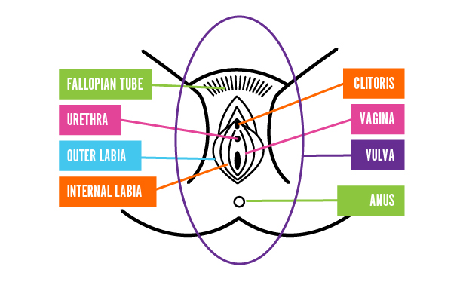
External reproductive organs
Mon Pubis
Clitoris
Urethra
Vagina
Outer Labia
Vulva
Inner Labia
Anus
Notes:
Explain that this is what is inside/outside someone’s body who has a vulva and vagina and is the external view of a vulva.
We often refer to the external genital organs (the bits you can see) as the vagina, but this is actually called the vulva. The vagina is the muscular tube inside the body that leads from the cervix (the opening of the womb) to the vulva.
Mons Pubis. This is the area above the labia, where people might have pubic hair.
Urethra. Below the clitoris, you will see a small dot or slit which is the opening of your urethra and where you wee/pass urine from.
Labia. There are 2 parts to the labia. 1) Outer labia – this might be covered in pubic hair and often fleshier, 2) Inner labia – this part does not have any pubic hair. The size and physical appearance of the labia can vary from person to person and there is no right or wrong way for it to look.
Clitoris. At the top of your labia, below the Mons Pubis, you will find the clitoris which looks like a small pea-shaped bump, with a hood of skin covering it. The sole purpose of the clitoris is to provide sexual pleasure. The clitoris is packed full of nerves, which means it can be extremely sensitive to touch.
Vagina. The vaginal opening is where blood comes from during a period and is where you can insert tampons or cups during a period.
Anus. This is found below the vaginal opening and is where you poo/pass faeces from.

Slide 16
All penises are different
Just like other parts of the body, all penises are different and unique.
Notes:
Need a QA penis image

Slide 17
Internal reproductive organs
Sperm Ducts
Penis
Glands
Testicles
Urethra
Notes:
This is what it looks like inside someone with a penis, this is their internal reproductive organs/ system
Penis – is made up of spongy tissue which hangs outside the body between someone’s legs. Some penises have a foreskin over the end of the penis to protect this sensitive area. It is important to gently pull the foreskin back to clean under it when you are having a wash. Some people might have had their foreskin removed during an operation by a doctor.
Urethra – this is a tube running inside a penis, connecting to the bladder and sperm ducts. It carries urine (wee/ pee) out of the body. It can also carry sperm out of the body through the penis.
Testicles – people have two of these and they hang outside of the body beside the penis. This is where sperm is made and stored. Sperm is something which is needed to grow a baby. Like the penis they are very sensitive to being touched.
Sperm Ducts- these help with the transfer of sperm from the testicles out to the penis
Glands –(prostate gland) this makes the fluid which helps the sperm travel to the penis. The fluid is called semen.

Slide 18
True / False Quiz!

Slide 19
1. The average age to start having periods is 12
TRUE
Notes:
The average age is 12, but the usual age range is between 8 and 12.
Don’t worry if you don’t start at the same time as your peers. If someone started their period at 18+, they should go to the GP for support around reproductive health.

Slide 20
2. You have your period every month for the rest of your life
FALSE
Notes:
You go through menopause aged between 45 and 55. The average is 51, and this is when your periods stop and you’re no longer able to naturally get pregnant.
Someone also might not have their period if they are pregnant, or experiencing other reproductive health issues that mean they do not have their periods every month. Stress and being underweight can also affect periods.

Slide 21
3. All periods hurt
FALSE
Notes:
Most people will experience period pain at some point of their lives. But not everyone.
It does not hurt when the blood leaves the vagina, though some people can feel it. What usually hurts is the cramps - when the uterus contracts as the lining falls away. This can be felt in the lower tummy, but also lower back.

Slide 22
4. Some people have heavier periods than others
TRUE
Notes:
Yes! We are all different. It is important if someone has heavy periods to think about their menstrual wellbeing, and to contact their GP if their pain is getting in the way of everyday activities, or they pass large clots for example.

Slide 23
5. It’s normal for someone to accidentally leak on their period
TRUE
Notes:
Yes, although you may find it embarrassing. It is normal, most people who menstruate have leaked or will leak at some point in their lives. If this is something you are worried about, carry some spare heavy flow products and some underwear.

Slide 24
6. All women have periods
FALSE
Notes:
To have a period, you need a uterus and ovaries. If somebody wasn’t born with these, they will not have a period. A trans woman would not have a period as they don’t have a uterus and ovaries. This does not mean they’re not a woman though.
A trans man may have their uterus and ovaries and hence still have a period. This may stop if they choose to have hormonal replacement therapy. Having a period does not mean they are not a man. Menopause, hormonal contraceptive choices and other conditions can make your periods stop. This does not mean they are no longer women. (Refer back to beginning slide about gender and bodies if this is needed).

Slide 25
7. You shouldn’t talk to your doctor about your period
FALSE
Notes:
Periods are completely natural and not something that generally requires medical attention, unless you have any concerns. If you are concerned, you can speak to your GP about your period. They can do tests and make sure everything is how it is supposed to be and also help you if anything was to go wrong. You can suggest a gender of doctor if you would feel more comfortable speaking to doctor who identifies as female.

Slide 26
Stigma…
We think we should talk about periods, our bodies and the menstrual cycle openly.
They’re natural and normal.
Let’s continue to break the stigma!
Notes:
Ask young people what stigma they think is attached to periods
Key Questions
What does stigma mean?
What might affect how we think about periods in society?
Is it harder to talk about in mixed groups? And if so, why?
What might make it difficult for people to talk about bodies and wellbeing in relation to periods?
Often menstruators are taught that periods should be hidden, covered up, secret and not talked about . Though there is no ‘wrong’ way to feel, periods are not something to be covered up or ashamed of. They are natural and unique to each person.
“The impact of stigma and shame around menstruation is felt across many areas of young people’s lives, from mental health, body image and self-esteem, to limiting activities and behaviours. It also acts as a barrier to communication and knowledge about bodies, and ways to care for them.” Plan International UK report
Taken from year 7 lesson plan to debrief the point

Slide 27
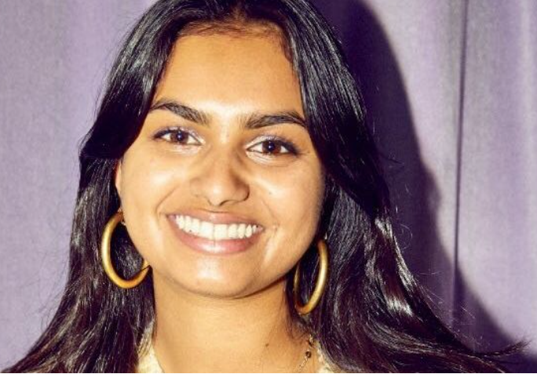
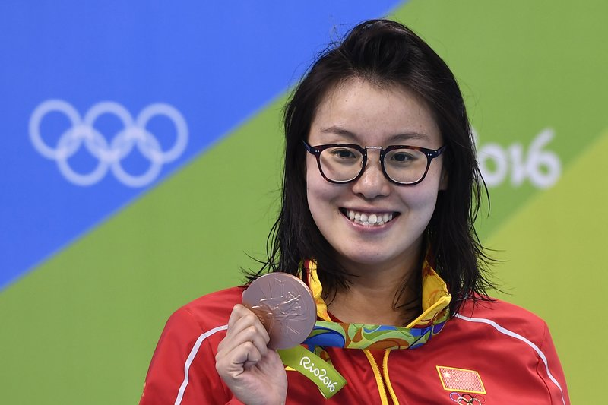
People challenging the stigma
Notes:
Not sure if we are allowed to use images like this in the Powerpoints, but we used these images in LTP and it was really useful for talking about taboos!
Kiran Ghandi ran the London marathon while free bleeding in 2015
Kenny Jones, A trans model who was the face of a period positivity campaign in 2018
Amika George, the prominent #FreePeriods activist who campaigned for period products to be made available in schools to young people experiencing period poverty
Olympic Swimmer Fu Yuanhui spoke about her period affecting her swimming performance in 2016
Rupi Kaur, an Indian-Canadian globally renowned feminist poet, posts an image of her bleeding on Instagram, that subsequently gets removed from Instagram in 2018

Slide 28
How do we make a period friendly environment in society?
Talk about periods
Include people of all genders in the conversation! Any others?
Notes:
• We think we should talk about periods, our bodies and the menstrual cycle openly and make a more period friendly environment.
• “The impact of stigma and shame around menstruation is felt across many areas of young people’s lives, from mental health, body image and self-esteem, to limiting activities and behaviours. It also acts as a barrier to communication and knowledge about bodies, and ways to care for them.” Plan International UK report
• The more that people know about the menstruation, the less mysterious or scary it becomes. Is there someone you know who doesn’t know as much about periods and the menstrual cycle as you do now? Could you share some of your learnt knowledge?
• Include people of all genders in the conversation!
• Some other ideas for creating a period friendly environment are having free period products in school and other community settings, as well as student always being allowed to go to the toilet when they need to in class.

Slide 29
Summary
Puberty might affect everyone’s bodies differently
There are ways we can begin to break the stigma by talking about periods
It is not wrong or rude to know about bodies and how they work. We all have them.
Knowing where to go for help if we need to ask more questions about periods

Slide 30
Where to go for support
An adult you trust at home or school Brook’s website https://www.brook.org.uk/your-life/puberty/ https://www.brook.org.uk/your-life/period-faqs/ ChildLine – 0800 1111 https://www.childline.org.uk/info-advice/you-your-body/puberty/puberty-facts/ Support for trans and gender-diverse young people https://mermaidsuk.org.uk/

Slide 31
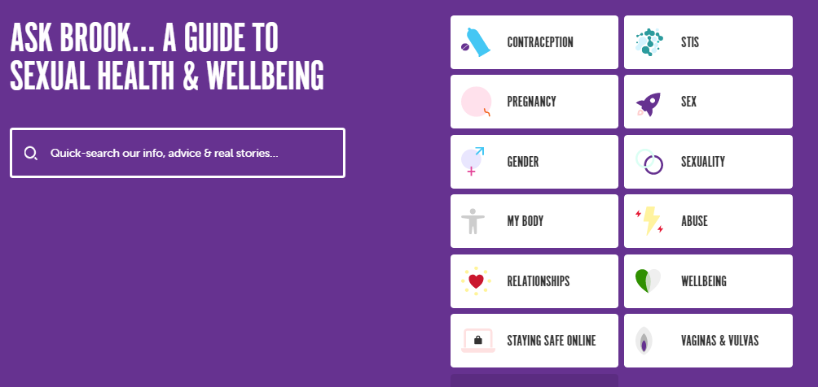
Ask Brook https://www.brook.org.uk/help-advice/

Slide 32
Thank you for listening
We hope you enjoyed it!
Do you have any questions?

