Slide 1


Slide 2
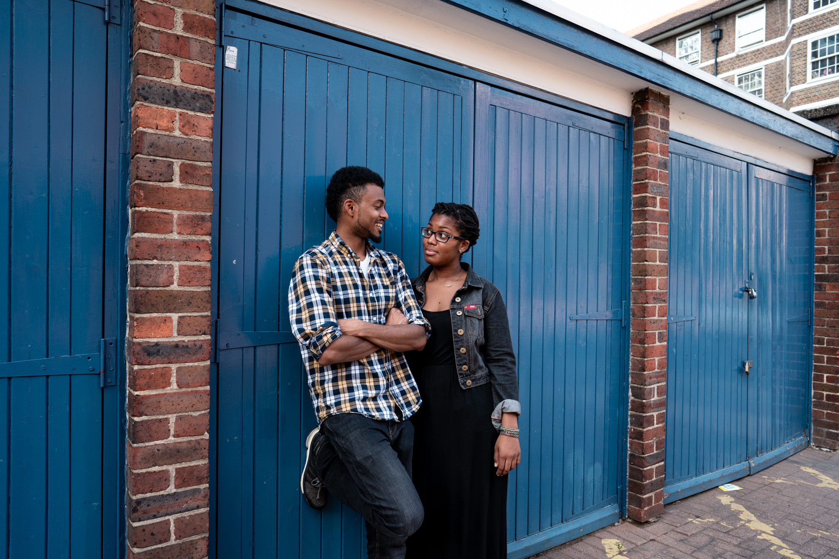
128,032 young people helped through our education & wellbeing work
What is Brook?
Young people rated our clinics 4.88 out of 5 stars
1.4 million young people helped face-to-face and online
Education programmes delivered in 35% of English local authorities
Notes:
Introduce Brook – some suggestions below
“In 1964, Helen Brook created a pioneering health service for young women who couldn’t access contraception anywhere else and desperately needed support. She refused to let stigma stand in the way of what was needed for these young women, despite fierce opposition.
Over 55 years later and Brook is at the forefront of providing sexual health services to young people. We support, educate and empower young people to make their own choices about their sexual health and wellbeing.”
Stats from Brooks Success report 2020 – number for the financial year 2019-2020
This shows we work with thousands of young people every year all over the country, supporting them with issues and questions they might have in around sex, their bodies and relationships
https://www.brook.org.uk/wp-content/uploads/2020/06/BR_SR_FINAL_DIGITAL.pdf
Our values are:
To be collaborative - We value young people’s right to be at the centre of decisions that affect them and work in partnership to provide opportunities to share their views, influence decisions and effect real change.
To be courageous - We relentlessly push the boundaries when fighting for change, supporting young people to build a society where people are free to explore their identities without stigma.
To be Trailblazing - Since 1964 we have championed the pioneering spirit of our founder, leading the way in meeting the ever-changing needs of young people.
To be Trustworthy- Young people rely on Brook’s confidential and non-judgemental approach to speak freely about the issues that affect them.

Slide 3



What is Brook?
Relationships & sex education
Advice & information
STI Testing
Contraception methods
FREE condoms
Pregnancy testing & advice
Counselling
brook.org.uk
Notes:
This might not be relevant to you right now, but it might be something for you to think about in the future, or for you to advise a friend or older relative.
Brook has services across the UK providing free and confidential sexual health services to young people under 25. Our Find a Service tool lets you search all services in England - not just Brook. If you haven’t visited Brook before, our visiting Brook page will tell you what to expect and if you need help urgently, we’ve got all the key numbers you need. Introduce local services.
Advice
Free condoms
Free contraception including emergency contraception
Pregnancy and Infection Testing
Someone to talk to
Support around who you fancy whoever that may be

Slide 4

Brook Space
Non- judgemental & Open
Respectful
Safe
Take Part
Ask questions (nothing personal)
Confidential
Fun
Language
Notes:
TASK - Create a Brook Space – Group agreement/ Group Rules
If time allows ask the group for suggestions for a group agreement
Be open but we won’t talk about our own personal lives
Non-judgmental- We will not assume we know what people think and feel or what’s going on in their lives, we accept that everyone is an individual
We will show everyone respect and not embarrass them or make fun of them in class or outside
We will all take part and get involved in the lessons but we have the right to pass on an activity
We will listen to each other
We can ask the teacher any questions (nothing personal though!)
We will try to use the correct language and not slang words, if we don’t know what the right word is we can ask (Mention if relevant)
We can ask for help and support outside class if we need to
Confidential – what we talk about remains in the room, unless we are concerned about you or something/someone you talk about – safeguarding
Make it fun
We will also use gender neutral language in this session, talking about bodies rather than gender to be inclusive or trans/non-binary/ gender fluid people (include if appropriate)

Slide 5
Session outcomes
Define what puberty means and recap body changes.
Understand that periods, experiences and bodies are unique for each person.
Name at least 4 different products which people can use to manage their periods.
Identify ways to help someone manage their own menstrual cycle or support others.
Understand where to go to ask for help and support with questions about our bodies.
Notes:
Facilitator runs through

Slide 6


Notes:
Key messages
1.For some of us, our bodies and our gender don’t match up. You may feel female and have a penis, you may feel male and have a vulva or may feel like a mix of the two. This is known as being trans, transgender, or genderqueer and can make puberty extra complicated; however puberty can still be positive. Please speak to someone you trust if anything is worrying you or if you have any questions.
2.Intersex – this describes a person whose biology doesn’t easily fit into ‘male’ or ‘female’ sexes and is far more common than we might think. It may mean they experience some aspects of puberty differently.
Therefore in this lesson, we are going to talk about people’s bodies, not genders

Slide 7

What is puberty?
Notes:
What is puberty?
Method
• Facilitator asks the group what puberty means? Have you learnt about it before? Take some suggestions
• Facilitator defines puberty using key messages and reinforces that puberty will be different for everyone
Key Questions
• What does puberty mean?
• Is puberty the same for everyone?
• What age does puberty happen?
Key Messages
•Puberty is when people start to change from being a child into an adult. Hormones (chemicals produced by your brain) cause your body to change and grow to become able to biologically conceive a baby. They also affect the way you think and feel.
•This can start any time from 7-16 years old. Not everyone develops at the same age or speed and it can take between 2-4 years to complete. Puberty is different for everyone, try not to compare yourself to other people.

Slide 8

For everyone
Grow Taller
You may get spots.
Grow more hair
Get sweatier, smellier and greasier hair
The hormones released in puberty can impact our emotions and feelings
You might start thinking about who you fancy and be interested in sex
You may want more independence and to take some more responsibility for yourself.
Notes:
•Grow Taller (you might feel more achy or tired as a result).
•You may get spots. – on your face, back and almost everywhere – not everyone will get them though
Grow more hair - growing hair especially on the legs, under arms and genitals (public hair). Some people will grow hair on other parts of their body too e.g. face, chest, back
Puberty makes us smellier, try to change your clothes and wash every day using soap or shower gel. Underarm spray such as deodorant (which covers up the smell) or antiperspirants (that stop or dry up sweat) can also help.
You’ll also need to keep your genitals clean. Avoid strong products. Unscented soap and warm water is all you need. If you have foreskin (skin over the head of your penis) wash gently under it to stop it getting smelly, itchy or sore.
Puberty can also affect the way we feel and our emotions especially as we manage the changes to our bodies. Try to be kind to yourself and people around you, without comparing to others. Do things which may you feel positive and support your mental health. Sleeping enough, doing some exercise and eating healthily can also help us feel more positive.
Part of puberty involves having sexual feelings, thinking more about sex and potentially who we might fancy. This might mean you start to think about your sexual orientation (which genders you are attracted to) but don’t worry if you’re not sure yet. In this wild mix of growing, changing and hormones it can take time to work things out.
You may find you want to explore your body and touch areas (penis/ vulva) for sexual pleasure. This is called masturbation and is a normal part of growing up. Make sure to have clean hands and do it in a private place.
•Wet dreams are when you lose semen (which is wet and mixed with sperm) from your penis during sleep. Some people remember having a nice dream but others just wake up to find a wet patch. It’s important to clean up afterwards and change your sheets etc. Wet dreams are completely normal, but not everyone has them. Girls and people with vulvas can have wet dreams too, meaning they can have sexual feelings and orgasm in their sleep, though these won’t involve erections or the release of semen.

Slide 9

Changes if you have a Penis
Your voice deepens (voice changes).
Your muscles develop and your chest gets broader.
Your genitals (penis and testicles) grow larger.
Your nipples can become sensitive for a short time and may swell.
You may get erections
Notes:
Your voice deepens (voice changes).
Your muscles develop and your chest gets broader.
Your genitals (penis and testicles) grow larger.
Your nipples can become sensitive for a short time and may swell.
Getting erections more often (when the penis grows stiff and sticks out from your body)- they can happen when you are sexually excited and even when you are not

Slide 10
Changes if you have a vulva
Your nipples and breasts will get bigger (you might wear a bra).
Your body shape may grow more curvy and your hips may get wider.
You might start to get vaginal discharge - clear/milky liquid in your underwear which keeps the vagina healthy.
Your periods will start.
Notes:
Your nipples and breasts will get bigger (you might wear a bra).
Your body shape may grow more curvy and your hips may get wider.
You might start to get vaginal discharge - clear/milky liquid in your underwear which keeps the vagina healthy.
Your periods will start. – we are going to learn about this more in the next activity

Slide 11
What the first thing you think of when you hear ‘periods’?
Notes:
What’s the first thing you think of when you hear ‘periods’
Method
•Facilitator asks the group to anonymously write down a word or phrase they think of when they hear ‘periods’ on a post it note (the young people can write down more than one). You may choose to state no swear words or offensive words for some groups.
•Facilitator then collects them in and reads out some to the whole group.
•Alternatively facilitator can just ask young people to shout out suggestions
•This question may bring up themes of embarrassment/shame/ taboo/ stigma around periods and it’s important to let the young people know that though there are no wrong ways to feel, periods are not something to be covered up or ashamed of. They are natural and unique to each person. Follow up questions could be ‘Why do people feel embarrassed?’ ‘ Why do people feel they’re dirty?’ ‘where does this come from?’ this is where you can talk about adverts, myths, boys often not being taught about them etc.
•Equally the group may not mention this theme (which would be great!) and instead focus on practicalities like pads etc. or how they feel and so on.
Key Questions
• What else do we call periods? Why do you think we have other words? Where does this come from?
• Do we often talk about periods? Is this only with certain people? Why do we think that is?
Key Messages
• Often menstruators are taught that periods should be hidden, covered up, secret and not talked about. Though there is no ‘wrong’ way to feel, periods are not something to be covered up or ashamed of. They are natural and unique to each person.
• “The impact of stigma and shame around menstruation is felt across many areas of young people’s lives, from mental health, body image and self-esteem, to limiting activities and behaviours. It also acts as a barrier to communication and knowledge about bodies, and ways to care for them.” Plan International UK report

Slide 12
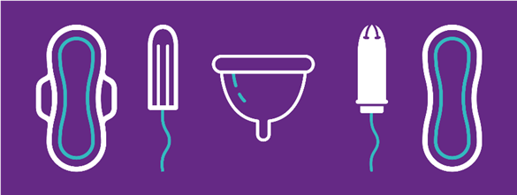
Periods or Menstruation
Every month (ish), the ovaries release an egg – this is called ovulation. If this egg is not fertilised by a sperm, the egg disperses in the uterus and comes out through the vagina, and this is what period blood is. A period will usually last for two to ten days.
Notes:
•Every month (ish), the ovaries release an egg – this is called ovulation. If this egg is not fertilised by a sperm, the egg disperses in the uterus and comes out through the vagina as blood. A period will usually last for two to ten days.
•In this session, we will be using the terms ‘period’ and ‘menstruation’, because they mean the same thing. Menstruation is the scientific term for a period.

Slide 13
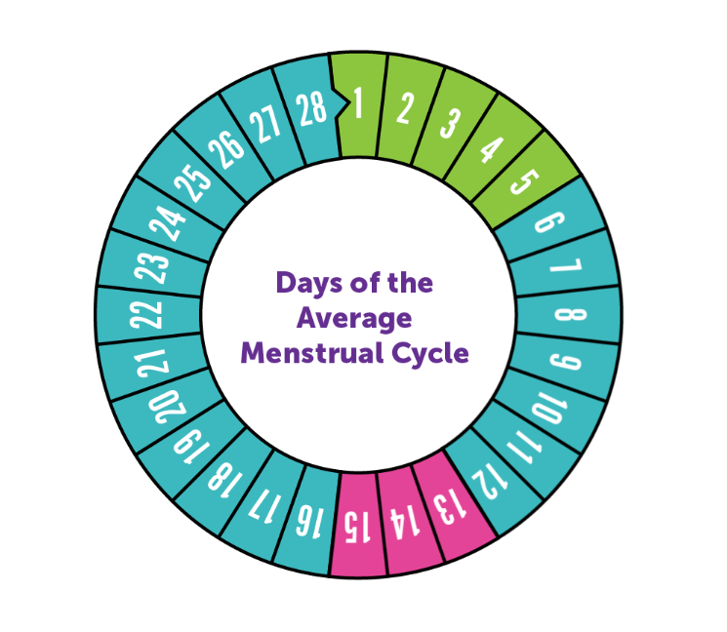
Period
Menstrual cycle
Post Ovulation
New Egg
Matures
Ovulation
Notes:
•In this session, we will be using the terms ‘period’ and ‘menstruation’, because they mean the same thing. Menstruation is the scientific term for a period. They are triggered by hormones released from the brain during puberty
•The average age to start is 12 but most people’s periods start between 8 and 14. If you have not started your period by the time you are 18 it is a good idea to speak to a doctor.
•Periods are part of the menstrual cycle. Day 1 of the menstrual cycle is the day that you get your period, and the menstrual cycle lasts until the day before your next one. Some people’s cycle may last away between 21 and 40 days
•A new egg grows and matures between days 6 and 12 of the menstrual cycle
•Around day 13 or 14 of the cycle the ovaries release an egg – this is called ovulation.
•Post ovulation is the time after the egg is released.
•If this egg is not fertilised by a sperm, the egg disperses in the uterus and comes out through the vagina, and this is what period blood is.
•There’s no ‘normal’ period or cycle, everyone is different! But usually they last a few days (commonly 3-8 days) passing between 5-12 teaspoons of pink, red or brown blood – this can be can be thick or watery. Periods can be irregular, heavy or light and can change throughout your life.
•It’s normal to get vaginal discharge throughout the month. The amount that comes out can vary, depending on where you’re at in your menstrual cycle. Sometimes discharge looks thick and white, and other times (when you’re releasing an egg, around ovulation) it looks stringy and clear. It can also have a yellowish look to it. The point of discharge is to keep the vagina moist, clean and healthy. It cleans the vagina by getting rid of dead cells and bacteria. So it is nothing to worry about, in fact it’s a sign everything is healthy and working as it should. If your vaginal discharge changes colour, consistency or smell this may be the sign of an infection, so it’s important to speak to a doctor.
•Use plain, unperfumed soap every day to gently wash your vulva. Never clean inside the vagina (douche) as it washes out the good bacteria. Always wipe front to back, to avoid transferring bacteria from the anus.

Slide 14

Tracking your cycle
Tracking your cycle can help you learn about your body and how you might feel at different stages. You might see patterns and learn what to expect.
You might want to use an app called Clue or use this paper tracker.
Notes:
Handout Brook Period Tracker

Slide 15
Period products bag
Notes:
Period Products
Method
• Facilitator asks the group how someone could manage the period blood? Take some suggestions
• Use the period products bag to cover different period management options, using Brook period handout sheets to debrief key points.
• Allow the young people to look at and handle the different options, asking any questions
• To extend the activity the facilitator can ask the class, in small groups, to list the pros and cons of each method, before feeding back to the wider group.
Key Questions
• What period products have you heard of?
• Are some options better than others?
• What factors might someone think about when choosing a period product?
• Do you only have to use one type of period product?
See period products sheet for product information

Slide 16
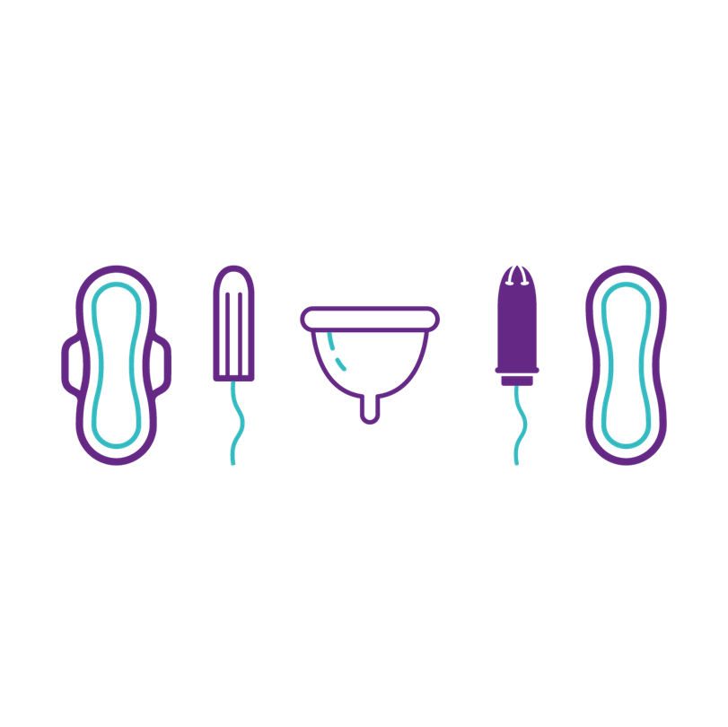
Experiment to find what works best for you. No one type of product is better, it’s just the best option for that person.
Notes:
Reinforcing positive messaging

Slide 17
Period Pictionary
Notes:
Period Pictionary & menstrual wellbeing activity
Method
Print out period Pictionary cards and hand out to a volunteer(s). If your class is big and two whiteboards are available, pick a couple.
The volunteer/facilitator draws the image from the card, and the first person to shout out the answer wins the point (and is given the card). If the group are new to the topic, give them some of the easier cards (such as none that involve the reproductive system, e.g. ovary). Limit or increase the number of cards dependent on time.
The facilitator asks the group to reflect on some of the menstrual wellbeing ideas we have mentioned in this activity – does anyone do any of these? (this can be private reflection, no one should be forced to share)
Facilitator leads a discussion on self-care and menstrual wellbeing during the menstrual cycle, using key questions and key messages to debrief.
Encourage young people to think about things they might need to support their own or others wellbeing during menstruation, encouraging conversations around self-care. Facilitator may choose to ask young people to reflect on this as a piece of follow up homework.
Key Questions
Why do we need to think about wellbeing during your period?
Why is it important to talk about period products as part of menstrual wellbeing?
Do we need to prepare in advance to look after ourselves before we get and during getting periods?
Does everyone experience the same period signs?
Does anyone have any top tips on what to do if you start your period unexpectedly?
Does anyone have any tips if someone has leaked or how to get rid of period stains from clothes?
What if people haven’t started their periods yet – does anyone have any advice?
Key Messages
Some common signs that you may have before or during your period are feeling cramps in your lower stomach or back, feeling tense, emotional or irritable before a period (known as PMS), breast tenderness, spots, upset stomach, tiredness, bloating, headaches. You won’t necessarily get all or any of these signs – everyone is different.
Cramps can be eased by taking Paracetamol or ibuprofen(always follow instructions carefully), using a hot water bottle, having a hot bath or doing some gentle exercise. Period cramps can be uncomfortable, but should not stop you doing normal things like going to school or work. If they are very painful please go to see your doctor for advice.
Remember your feelings are valid whether you are on your period or not – no one should disregard or mock how you feel by saying things like ‘are you on your period?’ This is not acceptable and often sexist.
Do something to make you feel positive, especially at particular times during your menstrual cycle. This could be going for a walk or relaxing in bed. Do what feels right for you.
If you have questions about your body, period or menstrual cycle please speak to an adult you trust. If you have very painful periods please don’t put off getting medical help.
What we need during our menstrual cycle will change, and that everyone experiences their menstrual cycle differently.
A little salt, baking soda or lemon juice (on lighter coloured clothes) all help with tougher stains. Always remember to use cold water too.
Having an emergency period product with you when you are out and about can be a good idea. But remember you can always ask friends or a teacher at school you trust too.
Tracking your cycle can help you learn about your body and how you might feel at different stages. You might see patterns and learn what to expect. You might want to use an app or a paper tracker. This can help with knowing when your period might be due, as well as how heavy it is, and so be more prepared.
The average age to start is 12 but most people’s periods start between 8 and 17. If you have not started your period by the time you are 17 it is a good idea to speak to a doctor.
“Signs that your period is on its way are if you've grown underarm and pubic hair. Typically, you'll start your periods about 2 years after your breasts start growing and about a year after getting a white vaginal discharge. The average girl will get her first period around 12 years old, but it varies from person to person.” NHS website
As a society, there are ways we can incorporate menstrual wellbeing at home, in school (free period products, assigned staff to discuss menstrual wellbeing with) and in wider cultures. Is there anything you could do to support menstrual wellbeing?

Slide 18
Menstrual wellbeing
Remember what we need during our menstrual cycle will change, and everyone experiences their menstrual cycle differently. This is totally normal
Do something to make you feel positive, especially at particular times during your menstrual cycle. This could be going for a walk or relaxing in bed. Do what feels right for you.
Notes:
Some common signs that you may have before or during your period are feeling cramps in your lower stomach or back, feeling tense, emotional or irritable before a period (known as PMS), breast tenderness, spots, upset stomach, tiredness, bloating, headaches. You won’t necessarily get all or any of these signs – everyone is different.
During your period some people get cramps which feel like a sore stomach or lower back. A warm bath, hot water bottle and keeping active can help. Any pain relief medication should only be given under adult supervision. Period cramps can be uncomfortable, but should not stop you doing normal things like going to school or work. If they are very painful please go to see your doctor for advice.
Remember your feelings are valid whether you are on your period or not – no one should disregard or mock how you feel by saying things like ‘are you on your period?’ This is not acceptable and often sexist.
Do something to make you feel positive, especially at particular times during your menstrual cycle. This could be going for a walk or relaxing in bed. Do what feels right for you.
If you have questions about your body, period or menstrual cycle please speak to an adult you trust. If you have very painful periods please don’t put off getting medical help.

Slide 19
If you’ve leaked…
Try not to panic, it is only natural that sometimes clothes or bed linen get stained during a period.
It can be useful to get an adult you trust or a friend to help you.
Use COLD water and soap to hand wash the stain (sooner is better than later), then when you can, pop it in the washing machine.
Avoiding leaks:
If you have heavy periods, use super tampons, high absorbency pads or menstrual cups
Don’t wear your favourite underwear on your period
Track your cycle
Track your period product usage
Listen to your body
Notes:
It is only natural that sometimes you may stain your clothes or bed linen during a period. The best way to remove any stains is to use COLD water and soap to hand wash the stain (sooner is better than later), then when you can, pop it in the washing machine. A little salt, baking soda or lemon juice (on lighter coloured clothes) all help with tougher stains.
Tracking your cycle can help you learn about your body and how you might feel at different stages. You might see patterns and learn what to expect. You might want to use an app or a paper tracker. This can help with knowing when your period might be due, as well as how heavy it is, and so be more prepared.

Slide 20
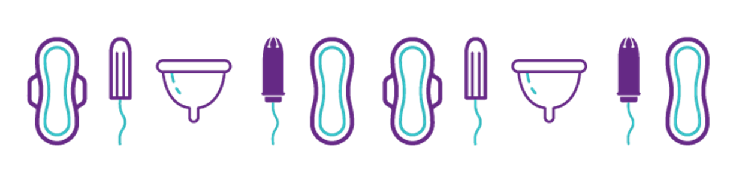
But I haven’t started yet…
Notes:
•The average age to start is 12 but most people’s periods start between 8 and 14. If you have not started your period by the time you are 18 it is a good idea to speak to a doctor.
• “Signs that your period is on its way are if you've grown underarm and pubic hair. Typically, you'll start your periods about 2 years after your breasts start growing and about a year after getting a white vaginal discharge. The average girl will get her first period around 12 years old, but it varies from person to person.” NHS website
•Having an emergency period product with you when you are out and about can be a good idea. But remember you can always ask friends or a teacher at school you trust too.

Slide 21

Summary
Puberty is when people start to change from being a child into a young adult.
People will start puberty at a slightly different time and will develop differently – it’s important to respect that we are all different.
There are many products and methods of wellbeing we can use to manage periods.
If you have questions about puberty or your body please speak to an adult you trust.

Slide 22
Where to go for support
An adult you trust at home or school
Brook’s website
https://www.brook.org.uk/your-life/puberty/
https://www.brook.org.uk/your-life/period-faqs/
Childline – 0800 1111
https://www.childline.org.uk/info-advice/you-your-body/puberty/puberty-facts/
Support for trans and gender-diverse young people
https://mermaidsuk.org.uk/

Slide 23
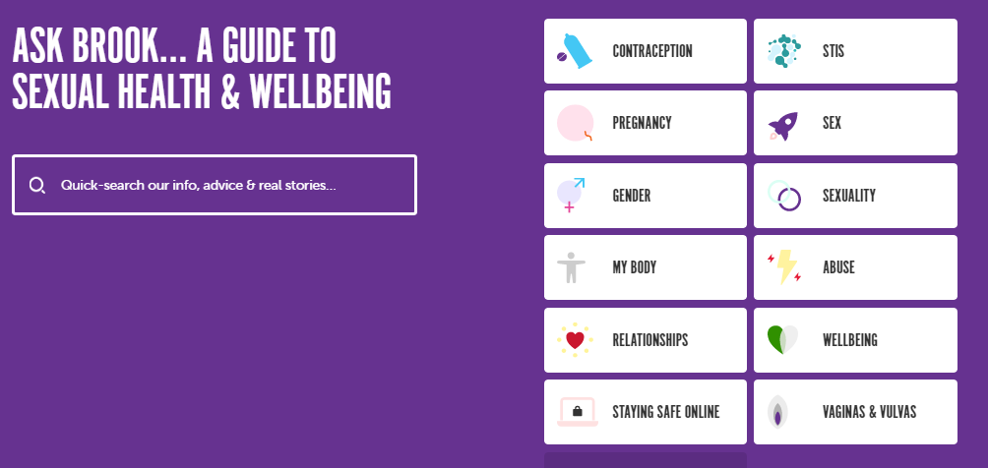
Ask Brook https://www.brook.org.uk/help-advice/

Slide 24
Thank you for listening
We hope you enjoyed it!
Do you have any questions?

